Slide 1
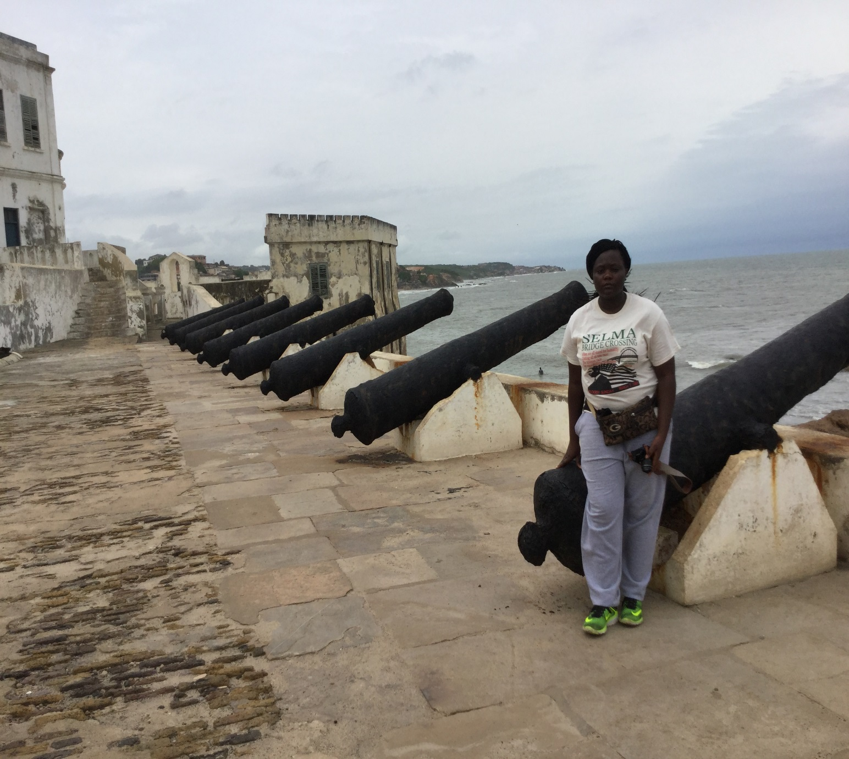
At The Cape Coast Castle

Slide 2
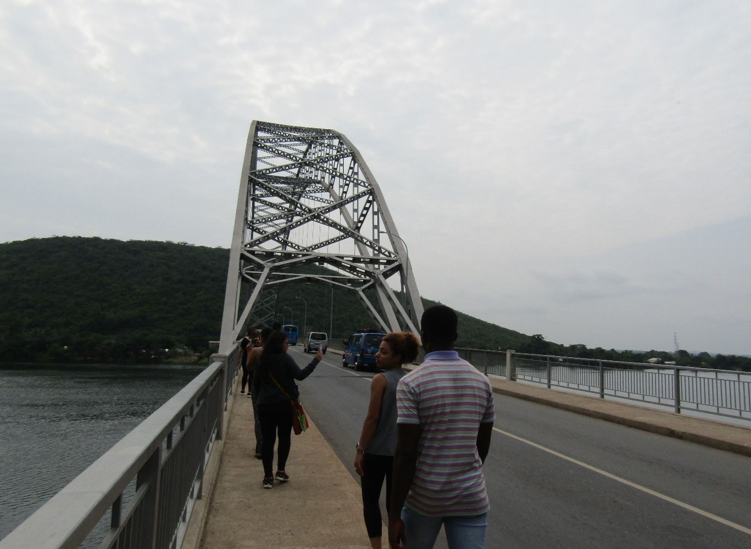
This is the Volta (Adami) Bridge. It reminds me of the Edmund Pettus Bridge in Selma

Slide 3
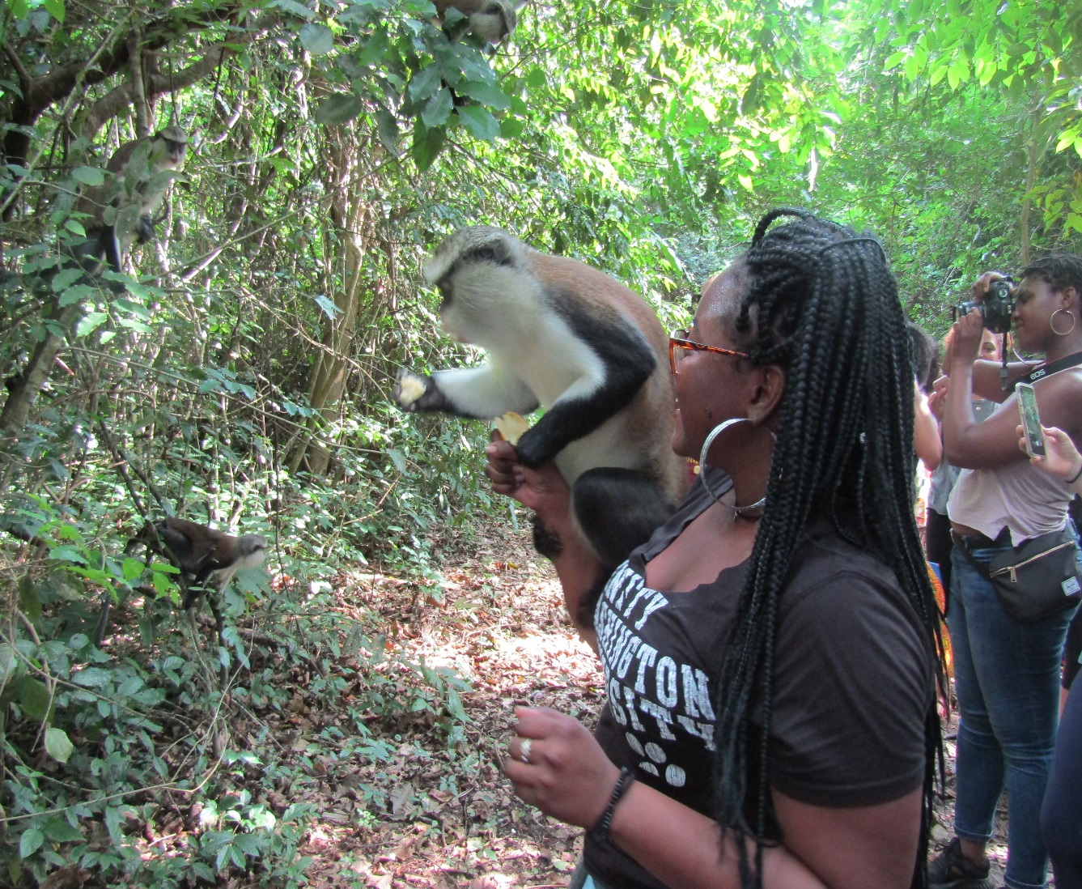
Shanta and Karrin at the “Tafi Atome Monkey Sanctuary”

Slide 4
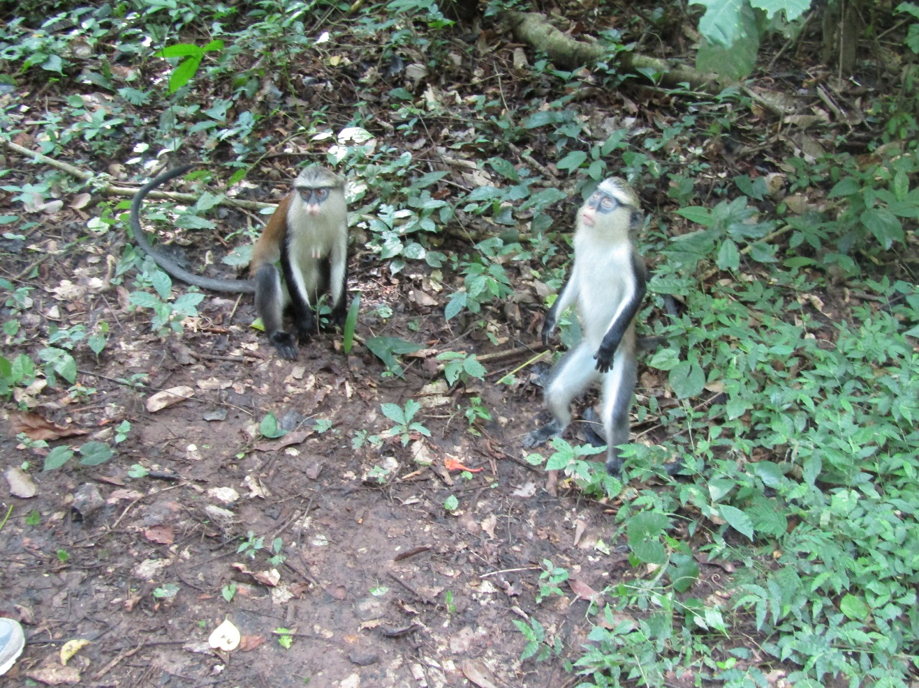
“Tafi Atome Monkey Sanctuary”: Mabel fed one the monkey

Slide 5
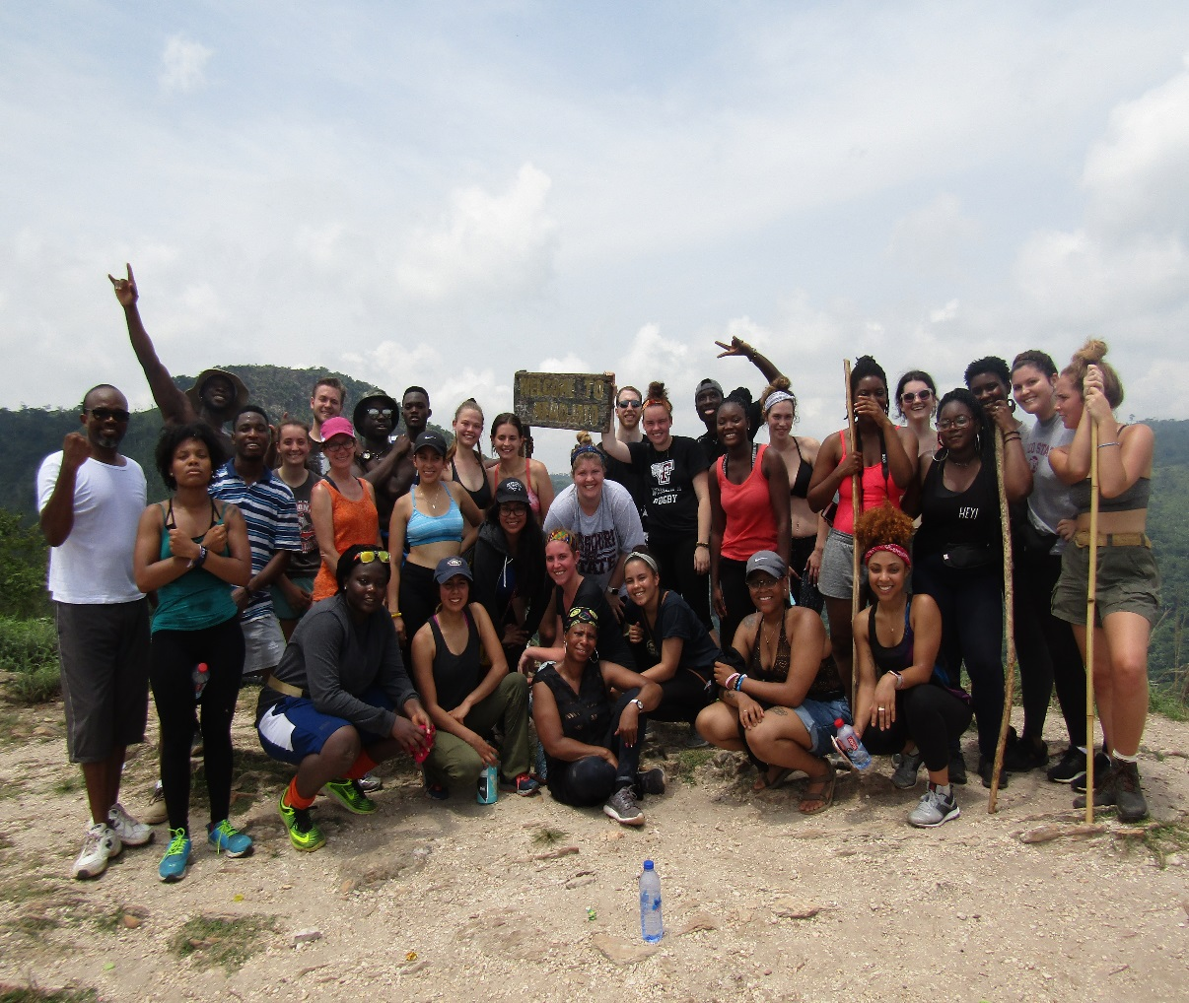
Mount Afadja: We made it to the top!!

Slide 6
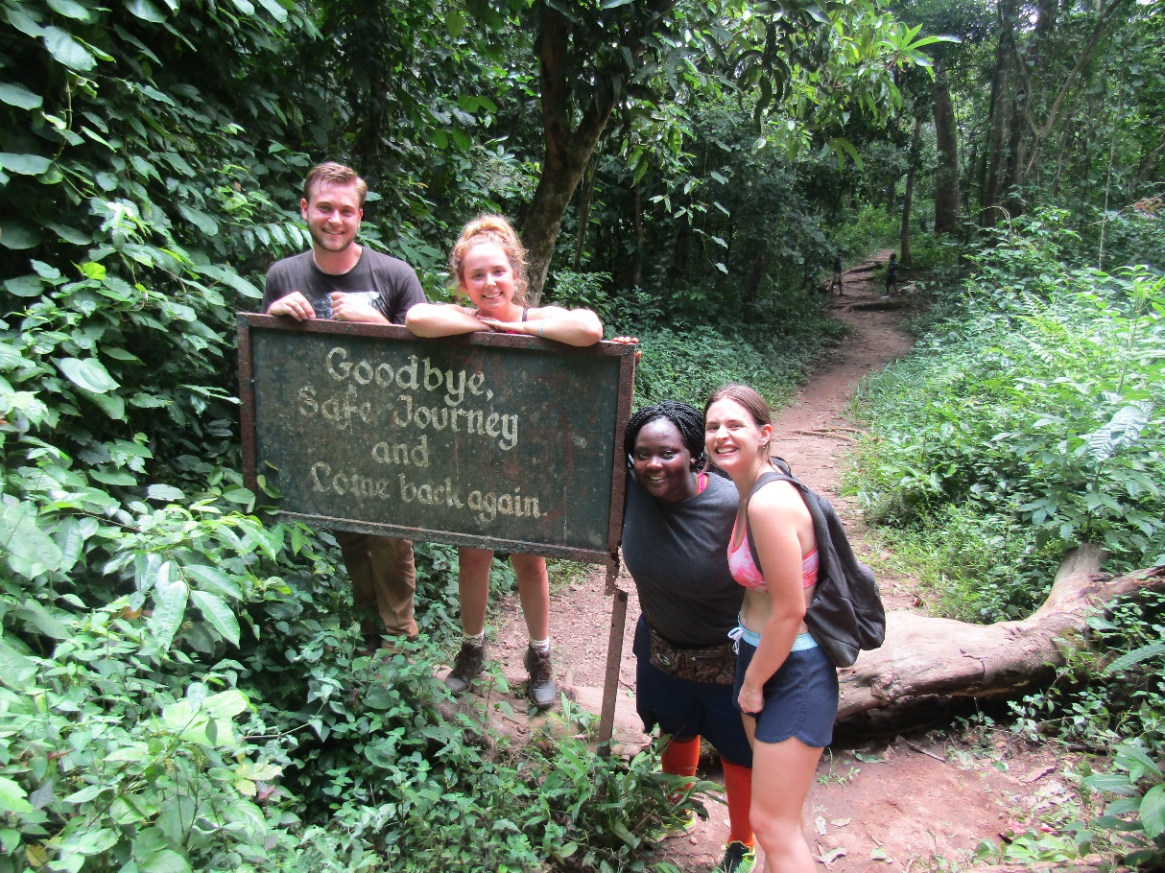
Mount Afadja with USAC students

Slide 7
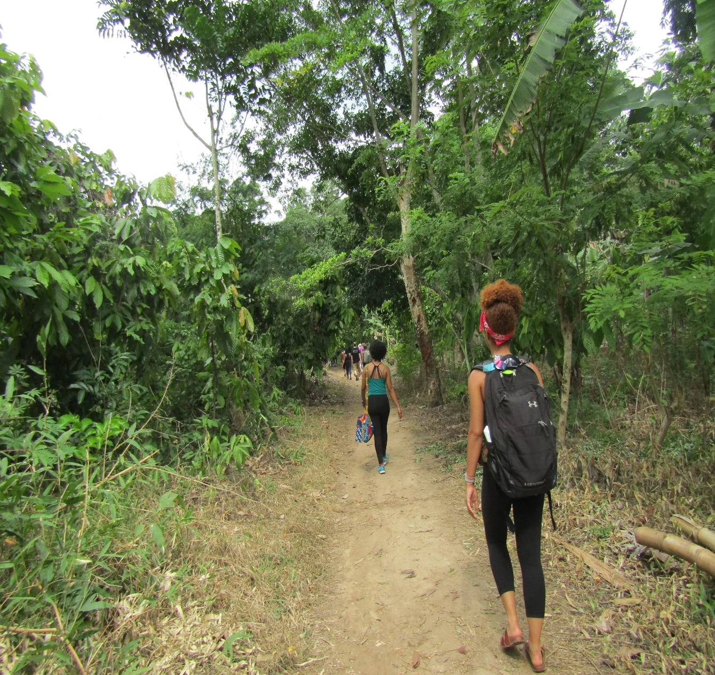
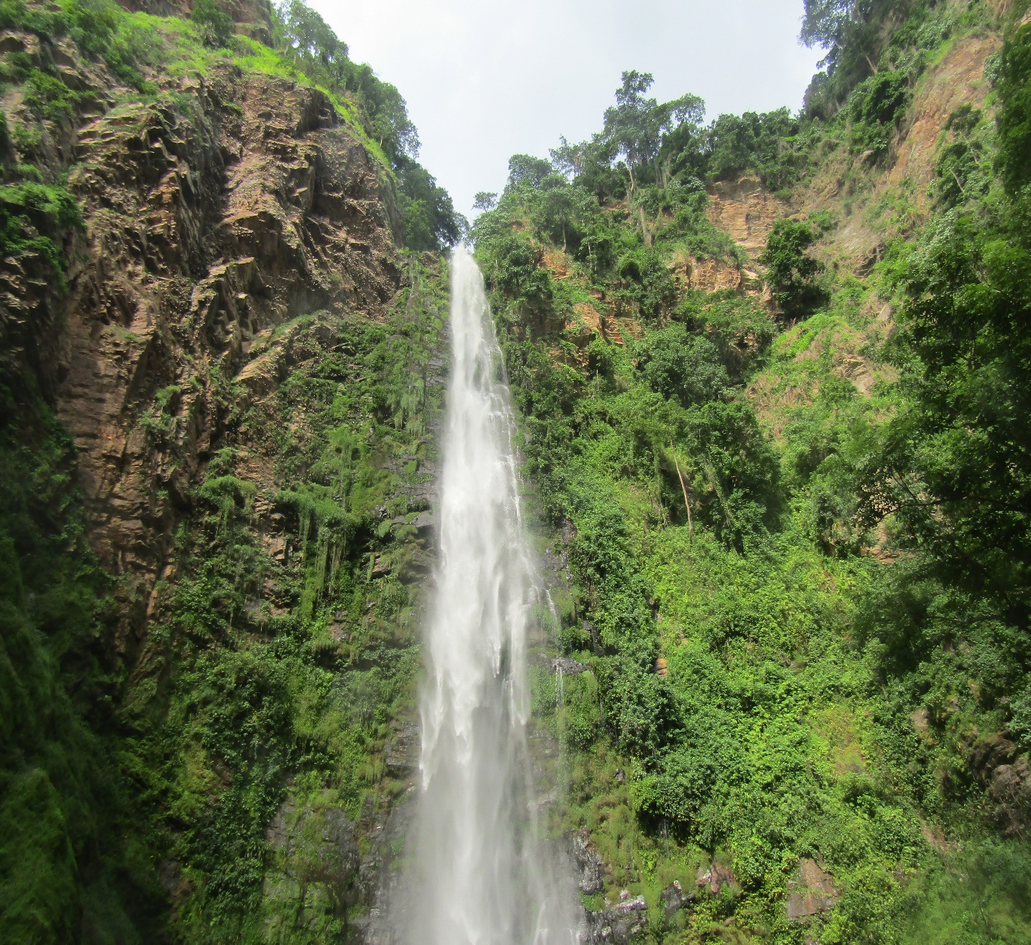
On our way to Wli Waterfalls: Destinee in front with the black book bag

Slide 8
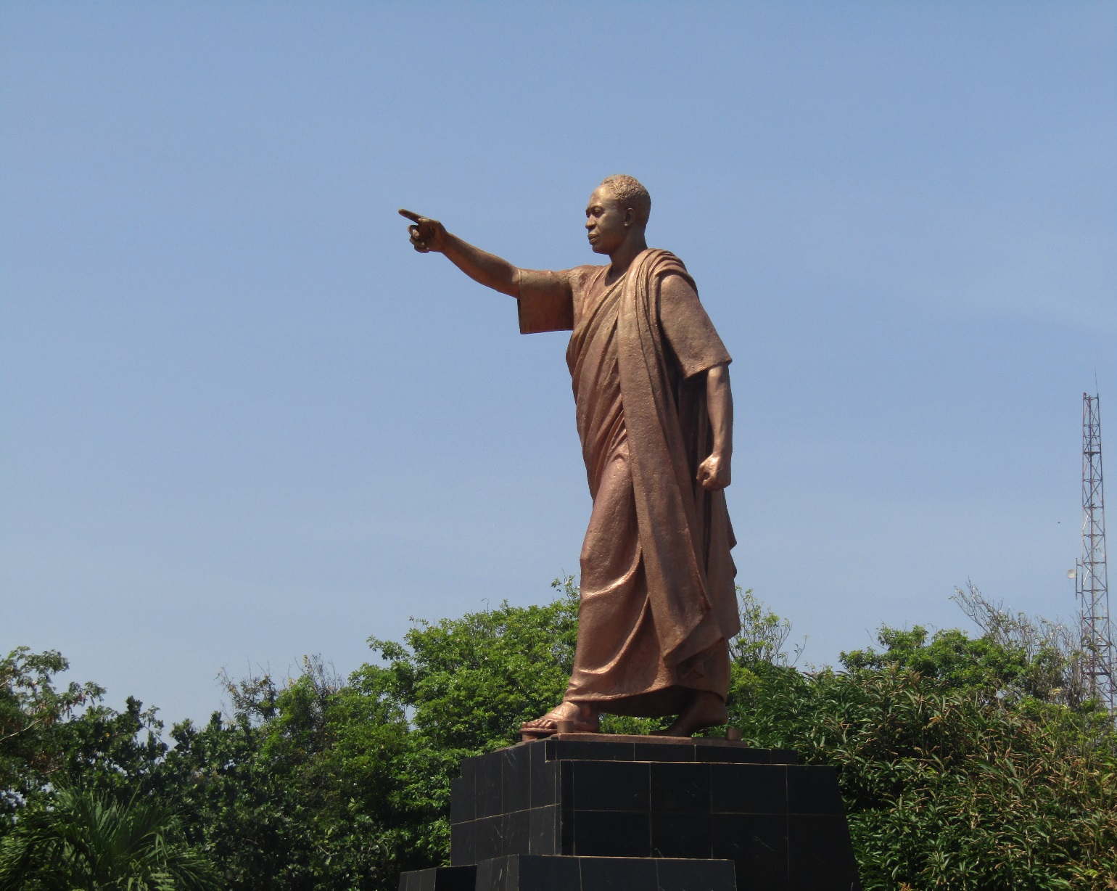
Kwame Nkrumah Mausoleum Memorial Park

Slide 9
