Slide 1
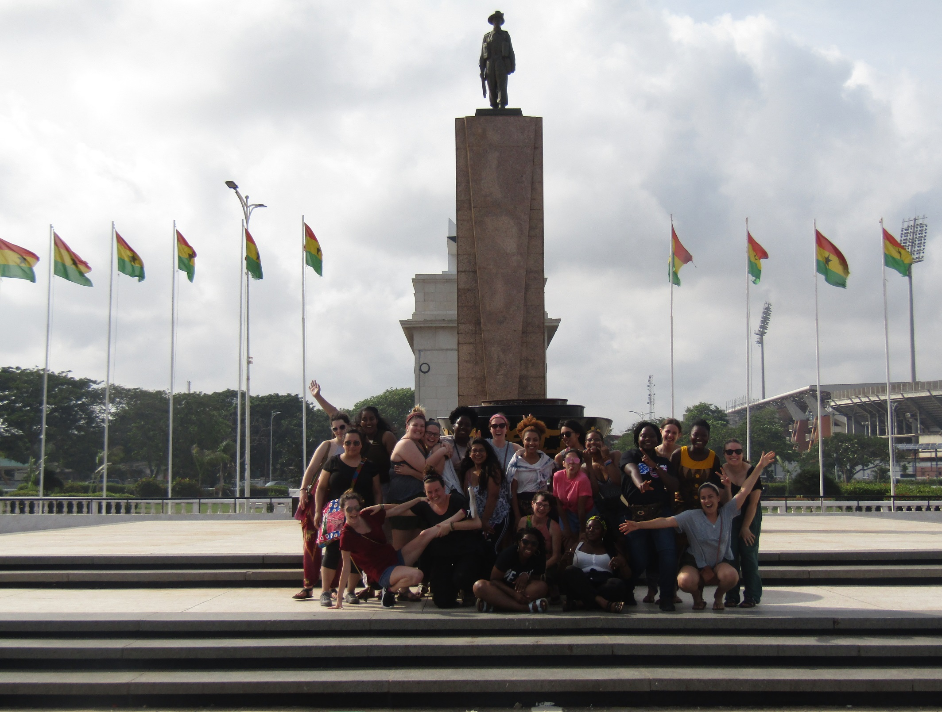
Downtown Accra

Slide 2
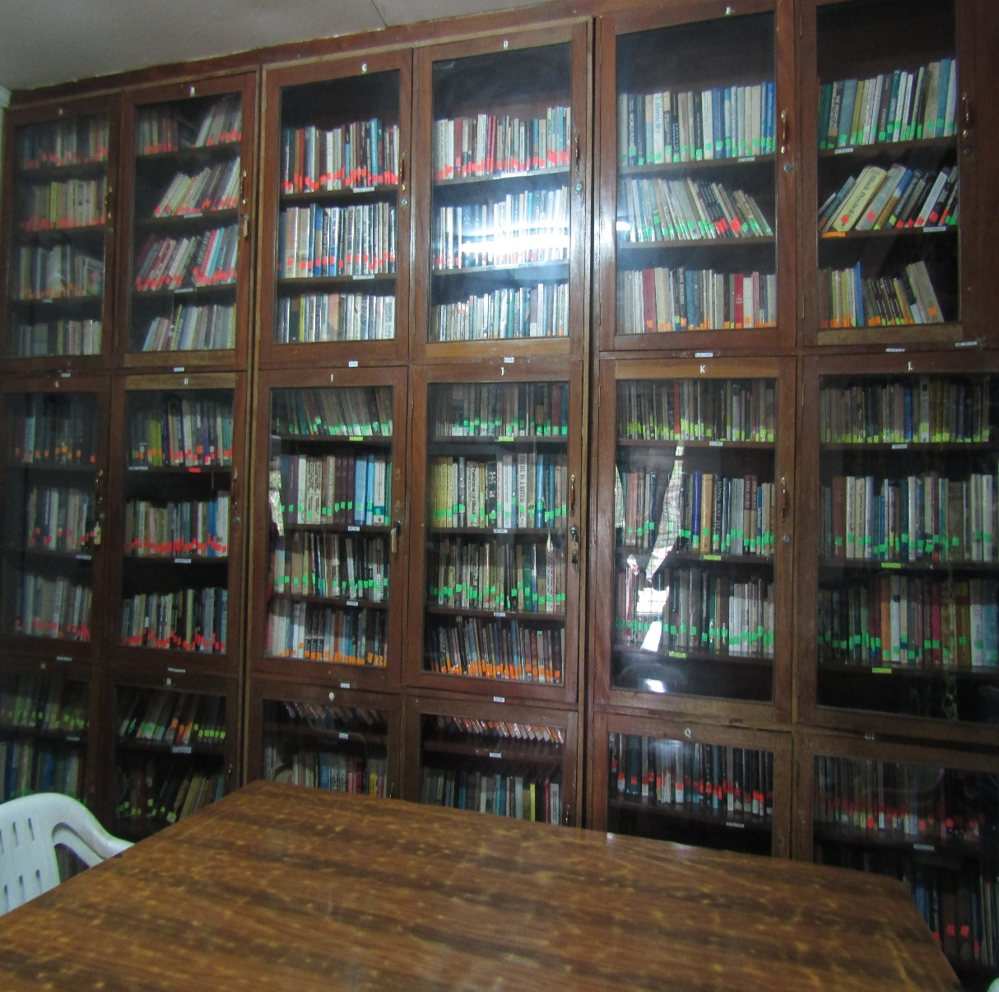
At The: W.E.B DU Bois Museum

Slide 3
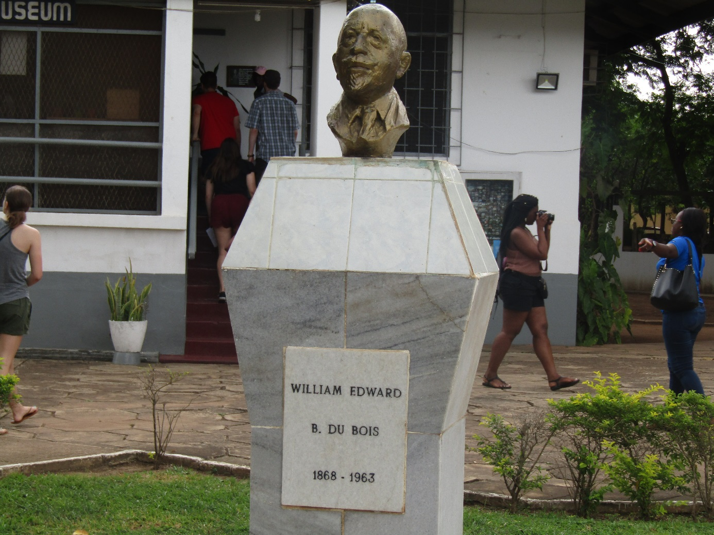
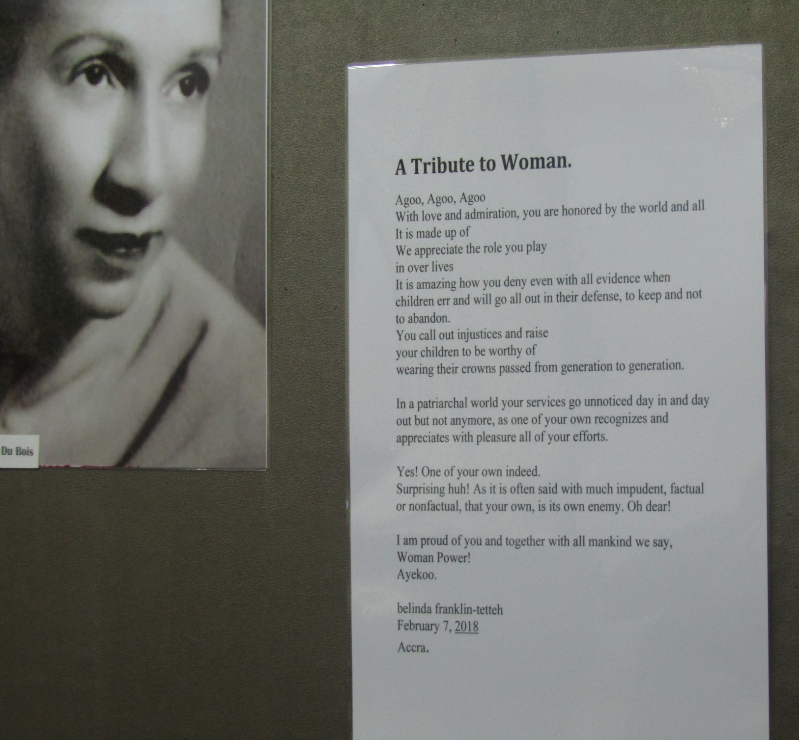

Slide 4
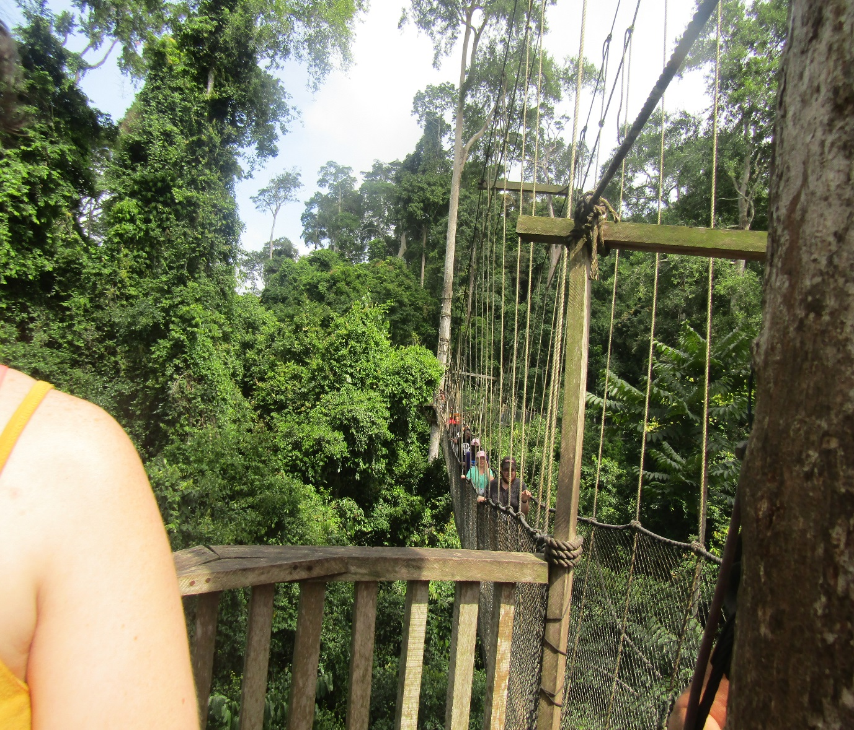
Kakum national park: Shanta, Destinee and others USAC students on the Kakum Canopy Walk

Slide 5
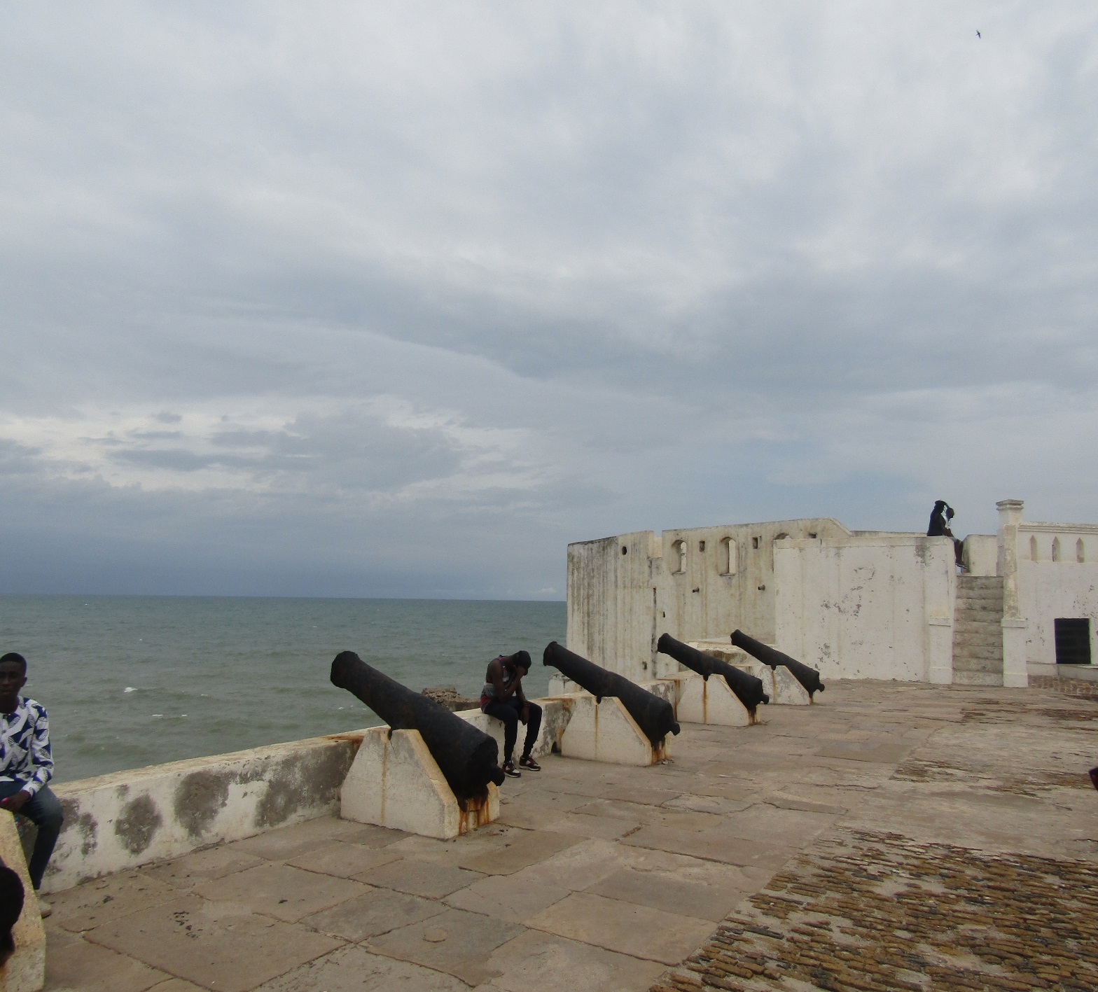
At The Cape Coast Castle

Slide 6
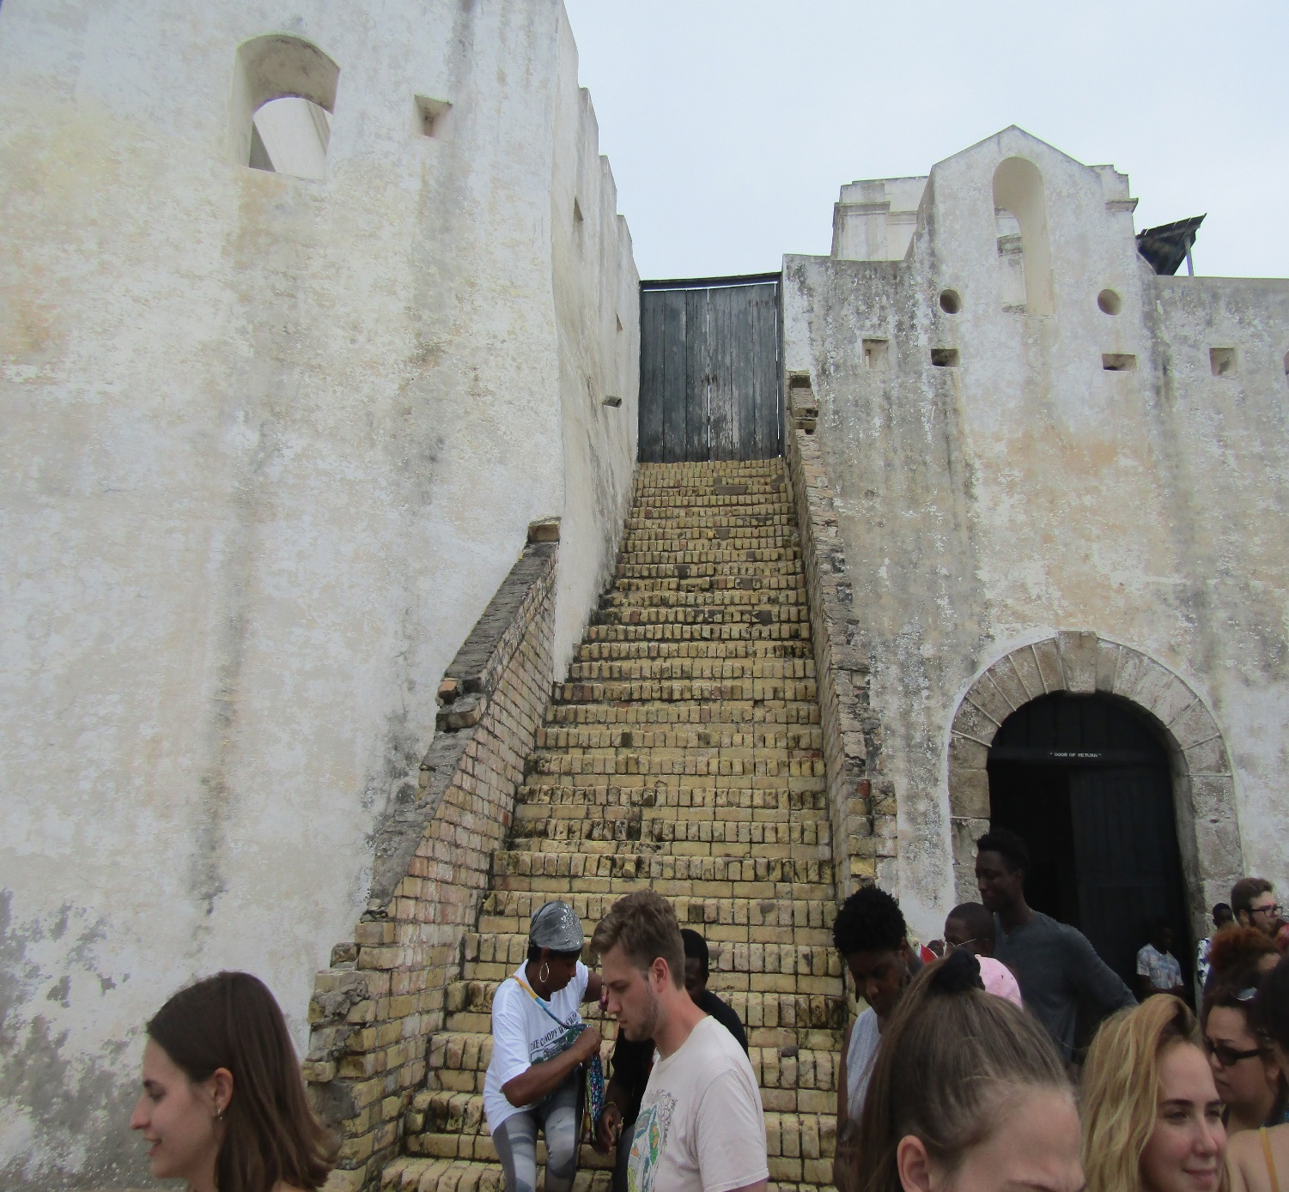
At The Cape Coast Castle

Slide 7
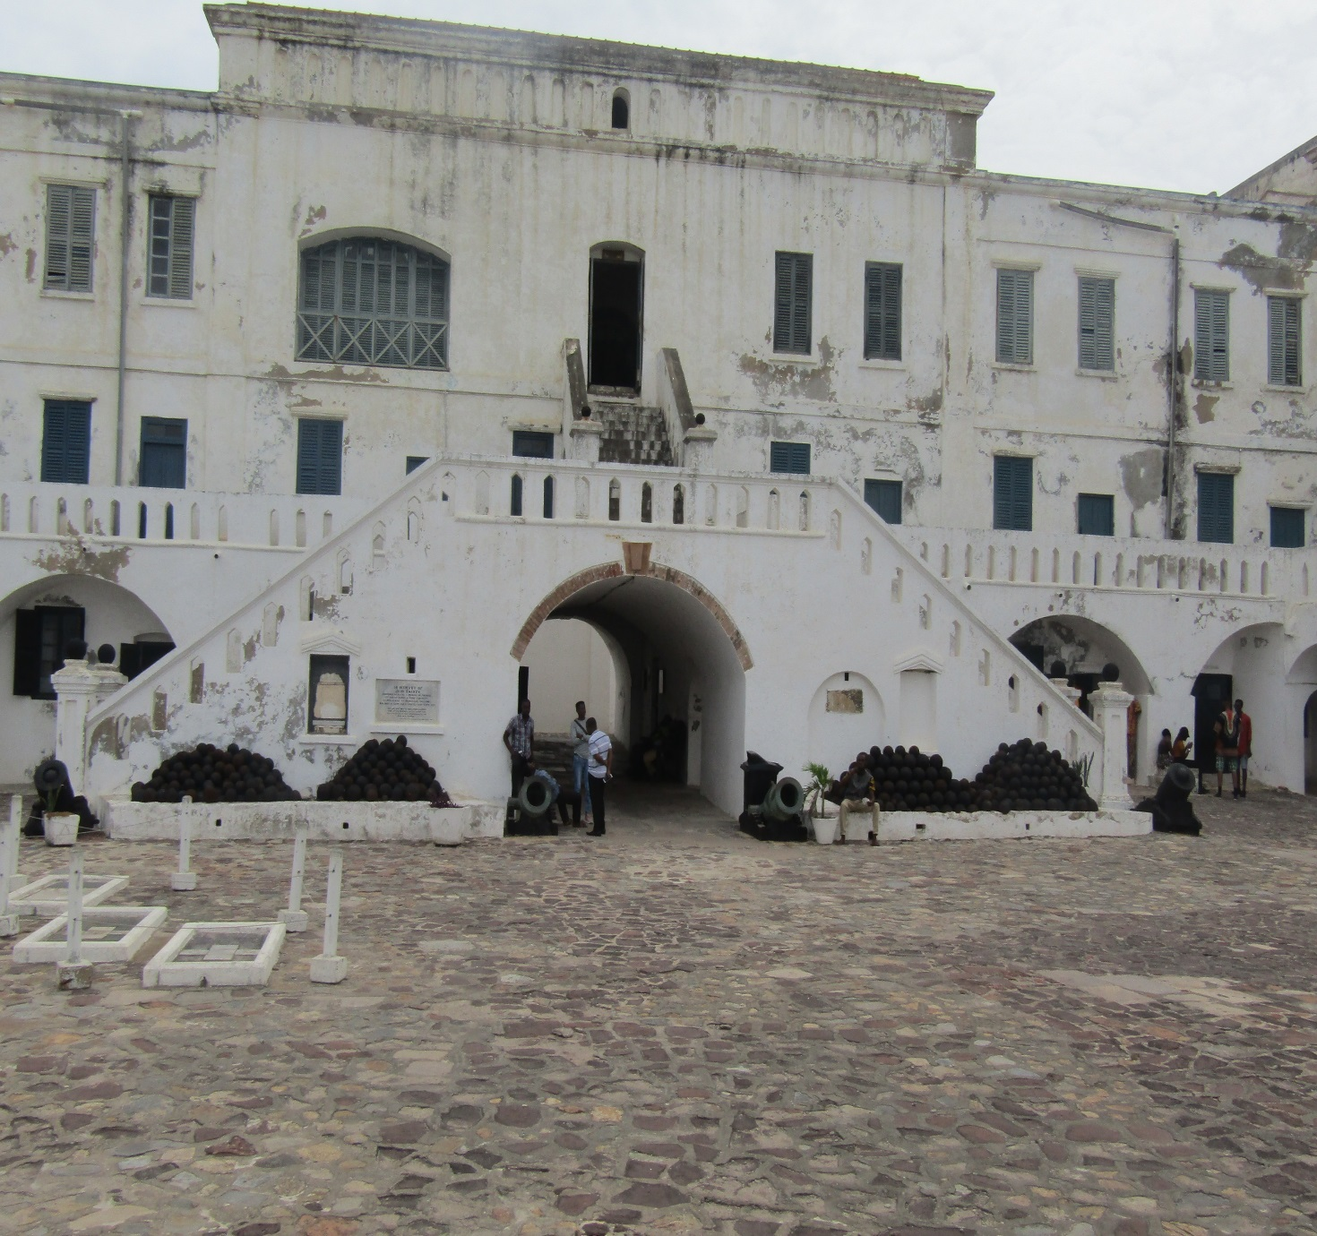
At The Cape Coast Castle

Slide 8
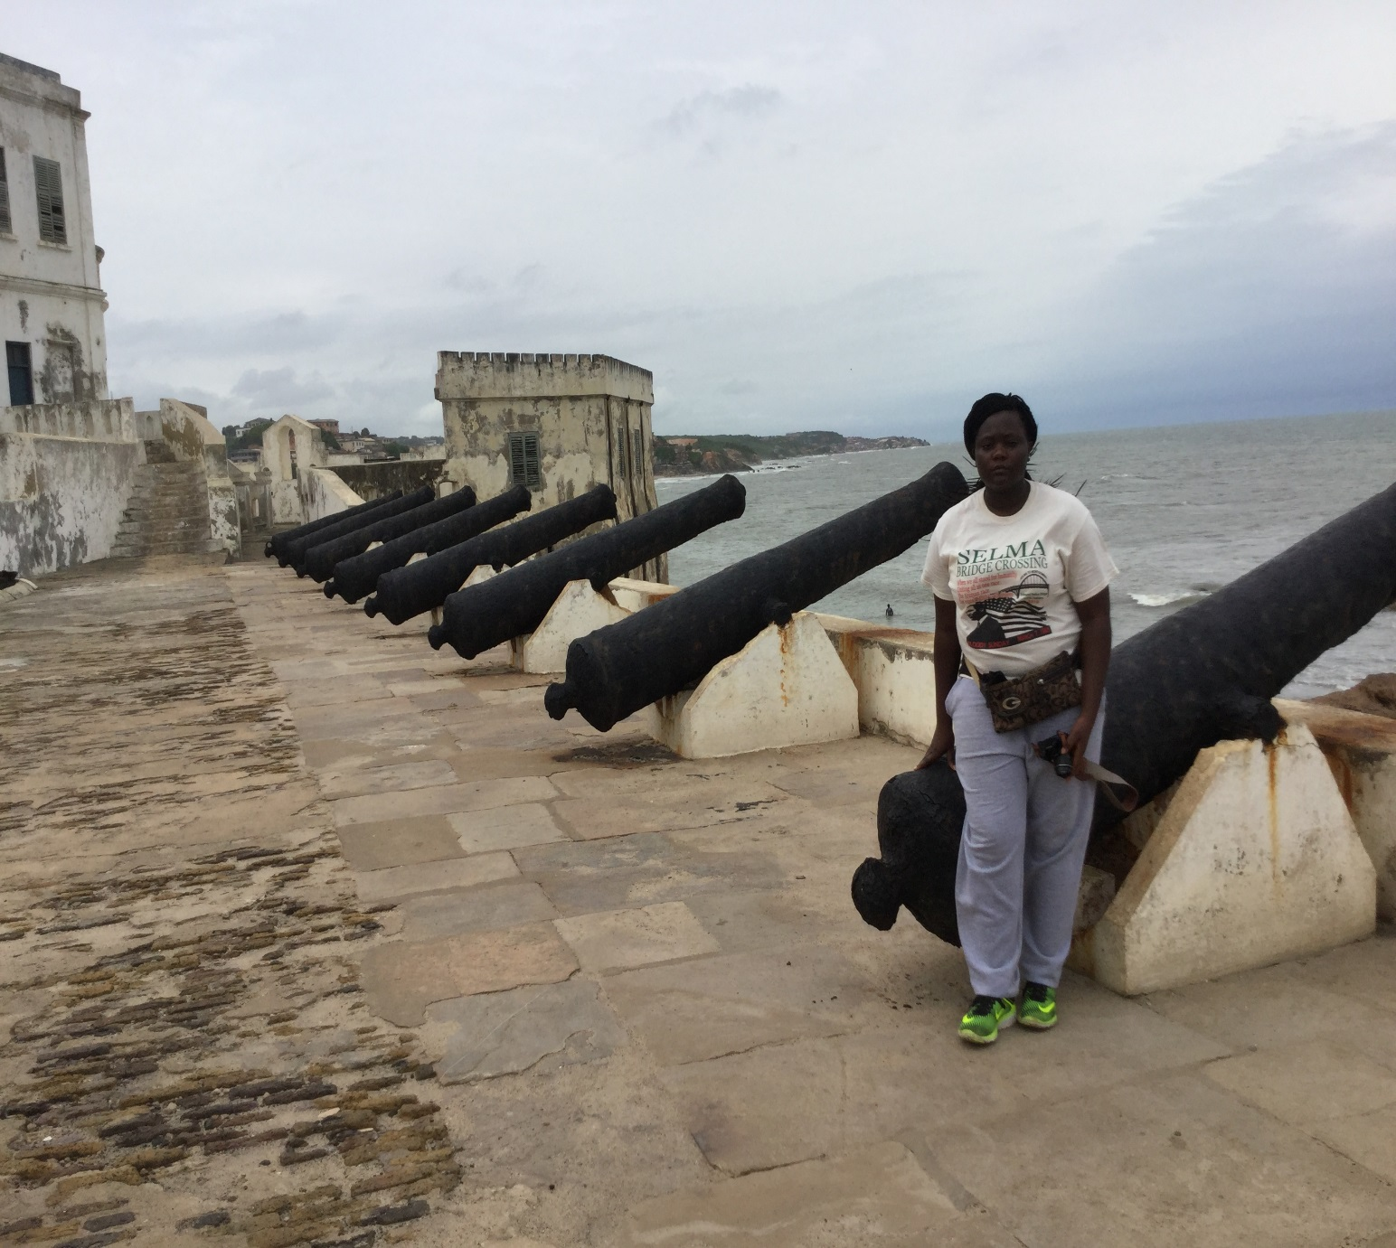
At The Cape Coast Castle

Slide 9
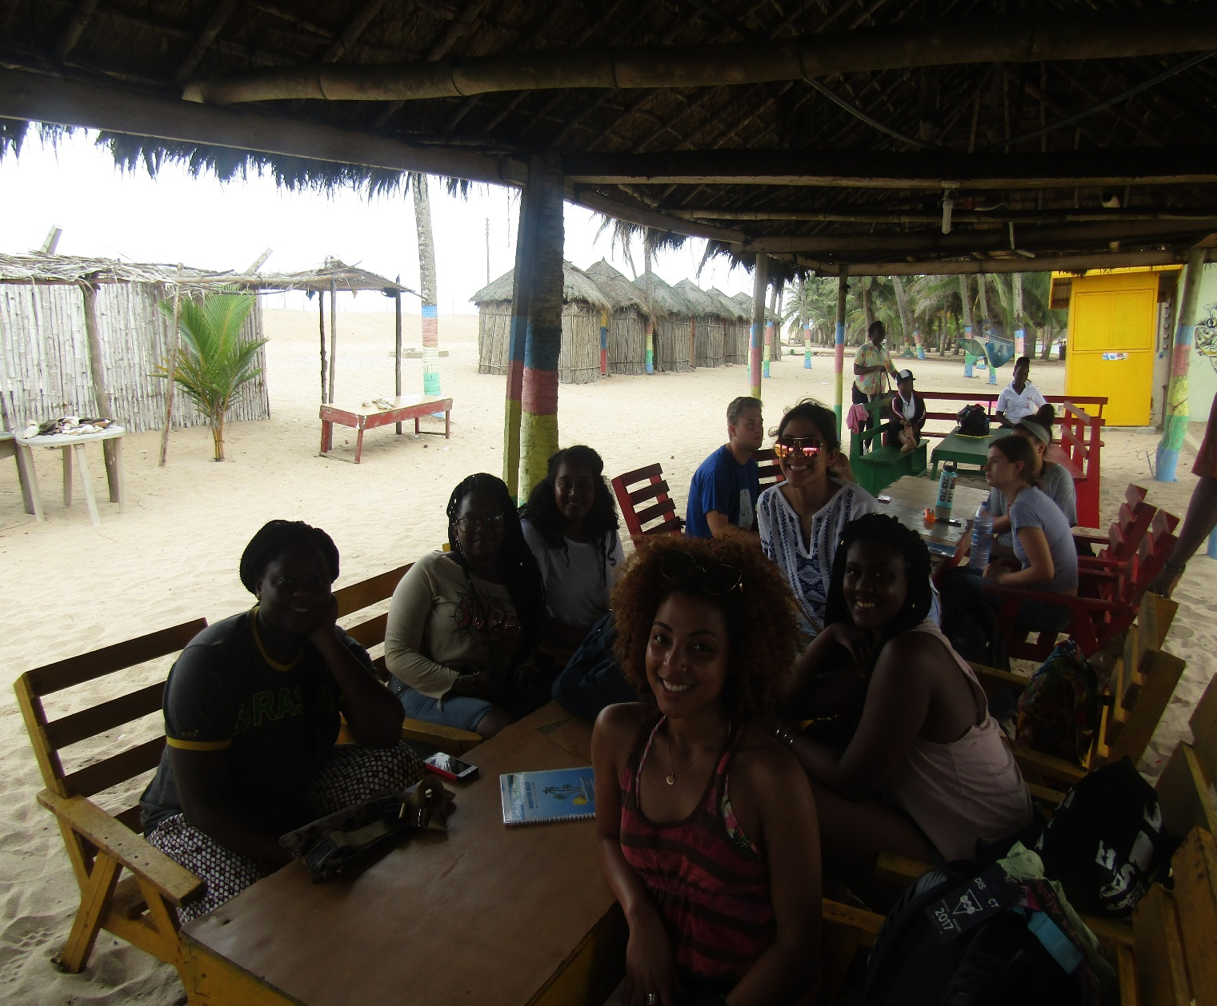
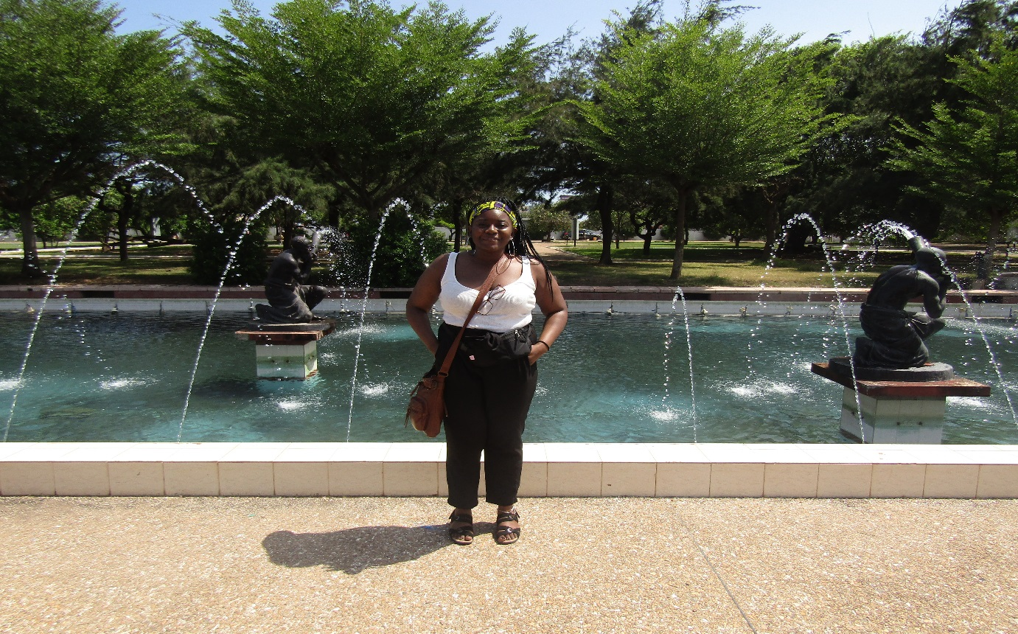
Mabel
Shanta
US

