Slide 1
Spring 2013 Writing Project: Plagiarism: Pedagogy v. Policing
President’s Remarks to the Faculty
January 11, 2013

Slide 2
Mission and Essential Purposes
Honor and integrity are essential values in the foundation of student intellectual , personal and spiritual development at Trinity. The Honor System embodies Trinity’s mission commitment to developing every student’s ethical framework for lifelong choices.
Every Trinity graduate must be able to demonstrate competency if not proficiency in writing at the collegiate level: this is a longstanding hallmark of a Trinity education
Graduate students must be able to demonstrate competency if not proficiency at the graduate school level
Diplomas represent actual learning, not the ability to organize surrogates for learning
Stewardship of the value and integrity of the Trinity degree is our most important corporate obligation, not just to the institution but to all of our graduates, their employers and the public trust

Slide 3
Plagiarism Agonistes
The topic of plagiarism afflicts us, conflicts us, harries us daily across many levels of work at Trinity
Plagiarism is evidence of a breach of ethical expectations, a choice to cut corners or cheat to get a better grade; even “unintentional” plagiarism reflects a failure to follow instructions, to internalize our teaching about writing, to exercise respectful care about academic work products;
A student who plagiarizes has not demonstrated the mastery of content or the competency in writing that is essential to earning the degree
We hate expelling students, but…… Awarding a degree to a student who has plagiarized erodes the integrity of the Trinity degree and its value for other students, and makes it less reliable for employers and the public trust
Failing to address plagiarism consistently, clearly and rigorously fails our stewardship obligation to Trinity

Slide 4
Dimensions of the Problem: Cheating and Plagiarism Cases 2010-2012 (This Slide Is Totally Borrowed from Provost Broaddus’ Slide Deck for the Senior Staff Retreat!!!)
 | Fall 2010 | Fall 2011 | Fall 2012
Total # of Cases | 30 | 39 | 75
Cheating | 9 | 1 | 12
Plagiarism | 31 | 38 | 63
Key Findings (*as noted by Sarah Wilson, Fall 2012)
The number of reported cases is increasing.*
Anecdotal evidence (conversations with faculty) indicates that many faculty are embracing the new policy and centralized procedures*
Many students (both undergraduate and graduate) expressed surprise at the ‘rules’ for citation and standards for conventional research.*
The paucity of reported cases in some areas/collegiate units may be cause for concern.

Slide 5
Plagiarism Deconstructed
Buying
a paper
online
or downloading
all or most of a paper
or assignment from another source
or another student
Linking paragraphs gathered from
many different places online with missing, fraudulent or incorrect citations, no quotation marks, no effort to identify the material as taken from another source, submitted in fulfillment of a requirement for writing a paper
Sentences, words and phrases, graphs and charts, scattered paragraphs taken from other sources without attribution, or with flawed attribution, but also evidence that the student has attempted to write some of the material herself, and sometimes showing some general idea about citation, e.g., endnotes, URLs embedded in some places
Level 1
Level 2
Level 3

Slide 6
Plagiarism Deconstructed: Why Do Students Plagiarize?
Buying
a paper
online
or downloading
all or most of a paper
or assignment from another source
or another student
Linking paragraphs gathered from
many different places online with missing, fraudulent or incorrect citations, no quotation marks, no effort to identify the material as taken from another source, submitted in fulfillment of a requirement for writing a paper
Sentences, words and phrases, graphs and charts, scattered paragraphs taken from other sources without attribution, or with flawed attribution, but also evidence that the student has attempted to write some of the material herself, and sometimes showing some general idea about citation, e.g., endnotes, URLs embedded in some places
Level 1
Clear Intent
to Cheat
Panic to Complete
Personal Crisis
Sloppy Academic Habits
Carelessness
Cluelessness
Internet Blindness: belief that assembling ideas of others is not a problem
Lack of Understanding
About Citations
Belief that this is good writing (it always worked before!)
Language Barriers
Level 2
Level 3

Slide 7
Plagiarism Agonistes Revisited
When is plagiarism an ethical failure on the student’s part?
When is plagiarism a failure to learn after effective teaching for good writing?
When is plagiarism evidence of ineffective teaching?
How do these questions affect our understanding of our roles and responsibilities for stewardship of institutional integrity?

Slide 8
Pedagogy v. Policing
Deconstructing plagiarism in order to rebuild our understanding of what part of our response can be in pedagogy versus what part of our response must be in policing
Taxonomy of the learning timetable: first year, underclass, senior, graduate student: what should students know and be able to do about citation and competent writing at each level?

Slide 9
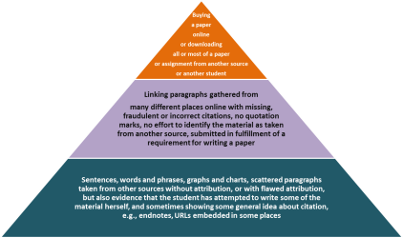
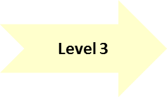
Pedagogy: Level 3
Pyramid Level 3: ineffective prior learning, confusion about citation, language barriers
WHO? First year, other underclass
WHAT? Analyze writing problems and develop specific pedagogical responses, curricular and in support services
HOW? Adopt a pervasive practice to encourage “revise and resubmit” when the errors are at the basic level and the students are underclass; plagiarism cases may still ensue if student work still shows evidence of plagiarism after opportunity to revise/resubmit

Slide 10
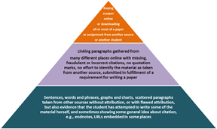
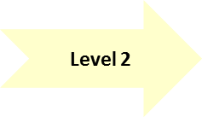
Pedagogy: Level 2
Pyramid Level 2: more substantial evidence of plagiarism due to sloppiness, carelessness, “internet blindness,” prior learning problems, language barriers remaining unaddressed
WHO? Undergraduates
WHAT? Detailed analysis of writing problems with specific course repeats or workshop requirements
HOW? Consistent practice across curriculum requiring drafts and revisions with close advising on writing; student failure to correct the problems will still result in plagiarism case review

Slide 11
Pedagogy Pitfalls
Beyond analyzing writing problems and developing more specific responses to them, faculty must also analyze and address problems in the design of assignments. Too many assignments lend themselves to rote copying of other texts, i.e., asking students to recite factual narratives rather than synthesizing knowledge.
Assignments that do not ask the student to create and express new ideas lend themselves to plagiarism.

Slide 12
Pedagogy Pitfalls (continued…)
Telling students “don’t bother with APA style it’s only a draft”
Stating or implying that first drafts or informal writing don’t need citations of any kind
Inconsistent messaging about correcting errors, revising and resubmitting
Taking assignments directly from prepackaged workbooks

Slide 13
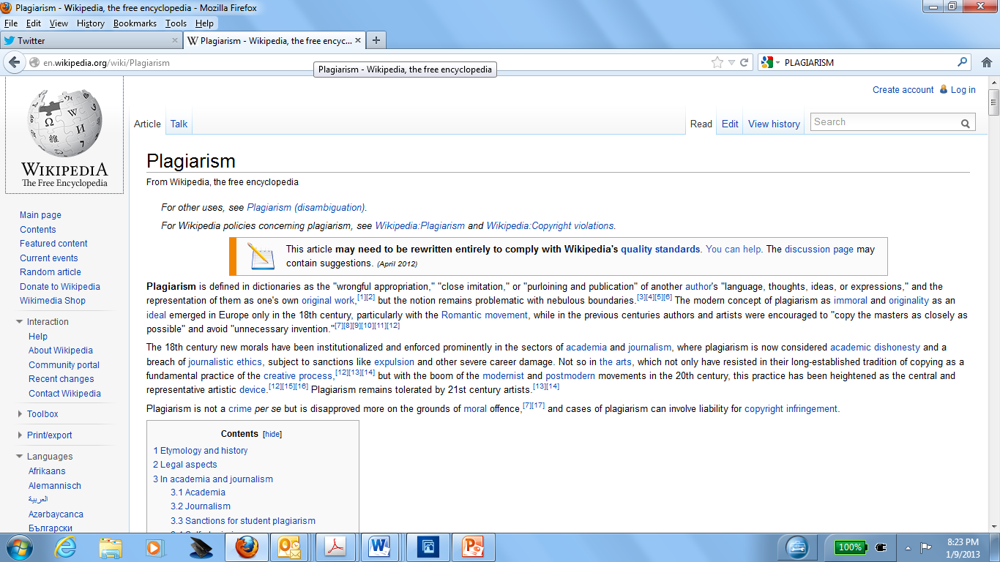
Pedagogy DARE…
BAN WIKIPEDIA!

Slide 14
Pedagogy: Graduate Students
We expect graduate students to have higher levels of proficiency in writing, but practice tells us this is not always true. Graduate students must develop improved writing competencies. Graduate students must also accept our methodology and not simply demand a commercial transaction to get a degree. Graduate degrees should mean higher-level proficiencies in research and writing.
We propose creation of a Graduate Writing Committee bridging all units to develop a comprehensive Trinity response to the graduate writing issues, including evaluation of master’s theses and other summative assessment projects.

Slide 15
Policing Plagiarism
Trinity’s plagiarism policy is clear in its definition of plagiarism and specification of the consequences.
This discussion will not change the ultimate outcomes for students who plagiarize, it simply allows more emphasis on a pedagogical solution for obvious writing problems before applying the policy
While effective pedagogy should be the first line of defense against plagiarism, at some point pedagogy must give way to policing
What is that point?

Slide 16
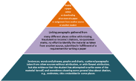
Policing Plagiarism
Level 1 offenses: wholesale downloading of papers or taking papers from other students. NO EXCUSES! Personal crises are terrible, yes, but do not excuse this kind of plagiarism at any level.
Level 2 and 3 offenses at the undergraduate level: “revise and resubmit” may be used if consistently applied, for one resubmission round, but following that, the plagiarism enforcement process ensues and the penalties apply
For graduate students: the policy stands

Slide 17
Faculty Responsibility and the Plagiarism Policy
Discussion today intended to frame a rational solution to the obvious need to do a better job teaching students how to write well and to avoid plagiarism; our goal is to have better writing and fewer plagiarism cases
Faculty do not have the option to ignore the plagiarism policy. Nor can faculty pick and choose to whom to apply the policy. Consistent application of the policy across the institution is imperative to avoid claims of discrimination.
The penalties prescribed in the policy will not change. Dismissal for seniors and graduate students is a penalty based on the clear obligation we have to protect the integrity of Trinity degrees. We cannot award degrees to individuals who have not demonstrated their own learning. Faculty must be at the forefront of promoting the ethical ideal of learning with honor and integrity at Trinity.

Slide 18
The Spring 2013 Writing Project
Much work has already ensued in the WID Project
Faculty understand the responsibility to address writing issues as well as ethical issues in every course in every discipline
Faculty will identify what kinds of support will facilitate improving teaching in writing and also in ethical education
Our goal is to reduce the number of plagiarism cases while increasing the writing proficiency of our students and graduates

