Slide 1
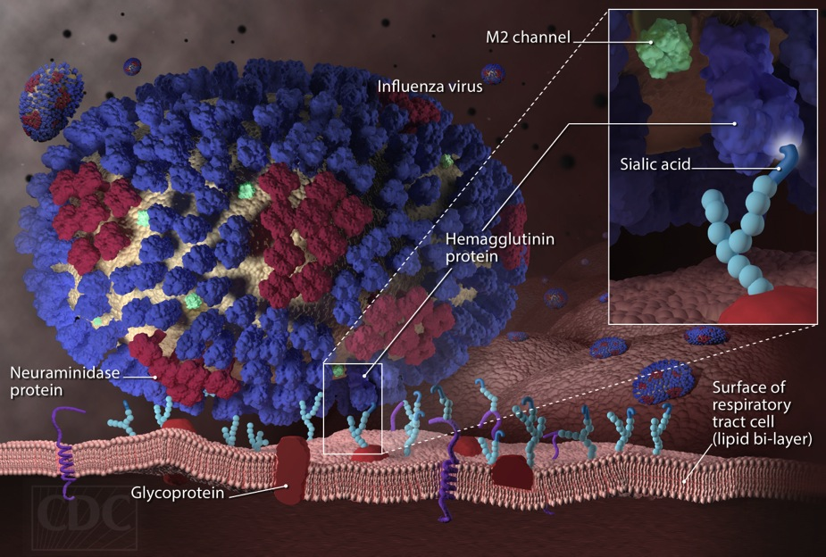
Resurrection: Reviving a Deadly Flu Virus
Karobi Moitra, PhD
Trinity Washington University
Washington, DC.

Slide 2
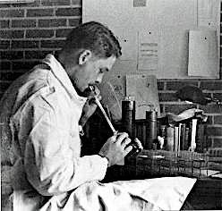
The year was 1950 and an eager 25 year old graduate student at the University of Iowa was searching for a PhD thesis topic. Nothing seemed to peak young Johan Hultin’s interest, but then something happened that would change the entire course of young Hultin’s life…

Slide 3
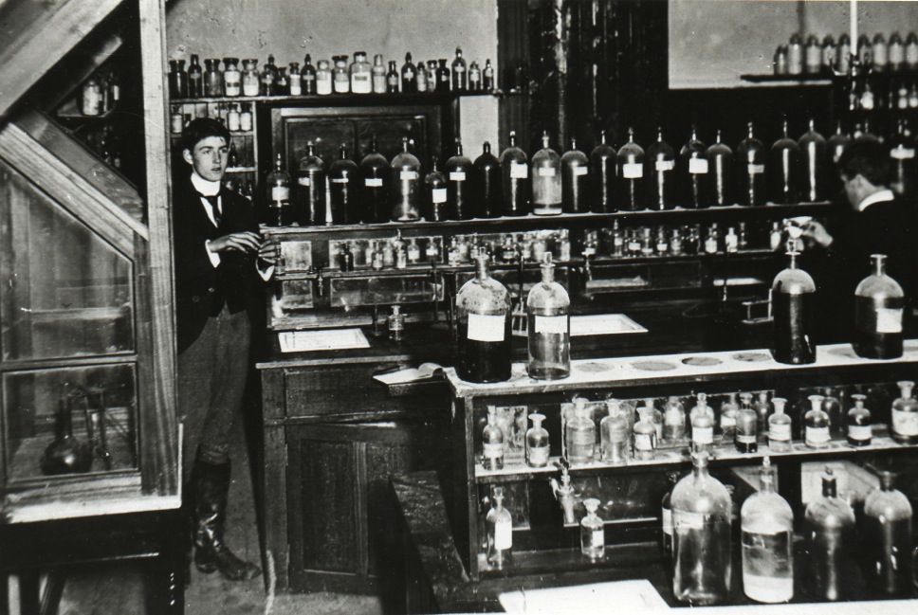
It was a routine day at the laboratory, the only bright spot in the otherwise drab day seemed to be a scheduled presentation by a visiting virologist (Dr. Hale) who was going to talk about the great influenza pandemic of 1918.

Slide 4
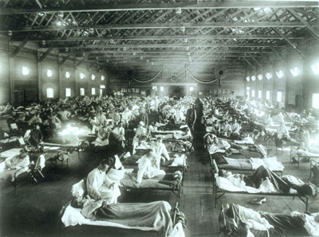
The Great Influenza Pandemic of 1918
The influenza pandemic of 1918 nearly decimated the
population of Europe. Approximately 20- 50 million human lives were lost because of the deadly pandemic.

Slide 5
CQ#1: Approximately how many people were killed during the 1918 pandemic?
5000
5 million
10 million
20-50 million

Slide 6
Explore the following websites and associated links
on the 1918 pandemic:
http://www.flu.gov/pandemic/history/1918/the_pandemic/influenza/index.html

Slide 7
CQ#2: Where did the 1918 influenza
come from?
Asia
Australia
Europe
Japan

Slide 8
CQ#3: How long did it take for the influenza
to spread from the military to the civilian
population?
4 months
2 months
6 months
1 year

Slide 9
CQ#4a: What kind of pathogen caused
the 1918 influenza?
Bacteria
Virus
Protozoan
Plant
CQ#4b: Form groups of 4-5 students and discuss
how you could positively identify the causal
pathogen of influenza in 2 contexts:
Given the tools available in 1918.
Given the tools available in the present day.

Slide 10
Why resurrect the 1918 inﬂuenza virus?
Hultin was at lunch with the speaker Dr. Hale when he heard him mention that there was only one way to solve the mystery of the 1918 pandemic - to recover the virus from a victim who had been buried in permafrost.
Hultin was one of those people who liked nothing better than to solve a good mystery and his interest was immediately peaked.
Hultin suddenly realized that he had found a topic for his elusive PhD thesis! The only question was; Where to find the body of a victim buried in permafrost?

Slide 11
CQ#5. Which mystery did Hultin want
to solve?
Death rate of the 1918 pandemic
How the virus affected the war
Historical influence of the influenza virus
Why the 1918 flu virus was so deadly

Slide 12
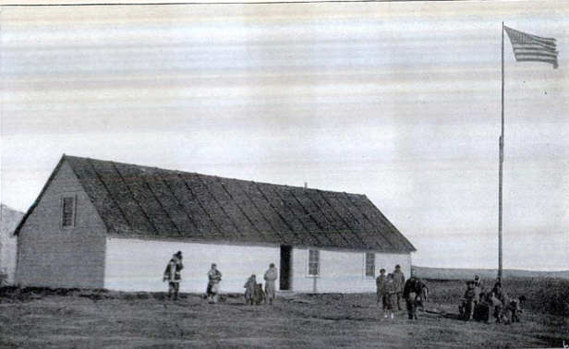
The Journey to Alaska
Hultin began to plan his journey. After some rigorous studying (involving permafrost and likely places where a body may be preserved) he came up with an ideal site in Alaska, the remote settlement of Brevig Mission on Seward Peninsula. In November 1918, 72 of the 80 residents of Brevig died of influenza and were buried in a mass grave.

Slide 13
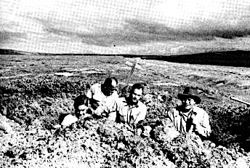
The Little Girl in the Blue Dress
Hultin arrived in Brevig and obtained permission to dig up the mass grave. It took two days of intensive labor hacking through the frozen ground until he came across the preserved body of a little girl in a blue dress with red ribbons in her hair.

Slide 14
Growing the Influenza Virus
Hultin and his group later found four more bodies and cut out samples of their peppered lungs and kept them frozen in dry ice. Back in Iowa, Hultin injected a solution of the lung tissue into fertilized chicken eggs - a standard method for growing ﬂu virus - and inoculated mice, rats and ﬁnally ferrets, which have a peculiar susceptibility to human ﬂu.

Slide 15
CQ#6: How did Hultin and his team
preserve the tissue samples?
In cold water
In ice
In dry ice
In formaldehyde

Slide 16

The Death of a Thesis
The virus, however, did not grow. Nothing worked. Nothing at all! If the virus was there at all, it was dead and so was Hultin's Ph.D. thesis.

Slide 17
Q#7. Why do you think that they could not
recover any virus from the samples?
They did not preserve samples correctly
They tried to culture it in the wrong animals
They used the wrong techniques
The virus could not remain intact in frozen
corpses

Slide 18
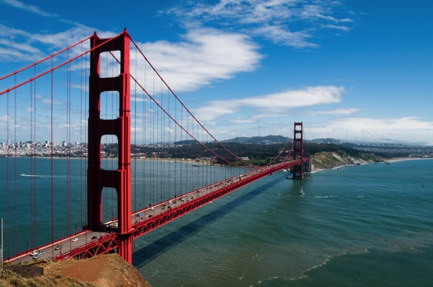
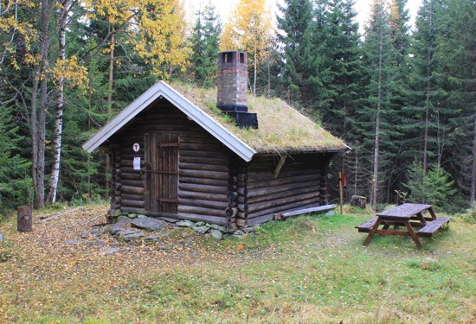
The Cost of Failure
Hultin eventually gave up. He went to medical school and became a very successful pathologist in San Francisco. In his spare time he traveled around the world, managed to invent auto-safety equipment and build a replica of a 14th-century Norwegian cabin. He also carried out research on Mount Everest but he never forgot about the only time in his life that he had failed.

Slide 19
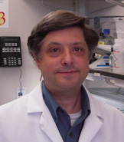
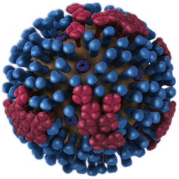

Flu Viruses Cannot Remain Intact in
Frozen Corpses
Jeffery Taubenberger was a man on a mission, to recover viral genetic material from the 1918 influenza virus. It was the 1990’s and Taubenberger had techniques at his disposal the Hultin couldn’t even imagine back in the 1950’s.

Slide 20
Even so, Taubenberger struggled for a year and a half and he was on the verge of giving up when he finally recovered a tiny fragment of viral genetic material from the lung of a soldier.

Slide 21
He amplified this fragment with a technique called
PCR or Polymerase Chain Reaction
Watch this video:
https://www.youtube.com/watch?v=iQsu3Kz9NYo

Slide 22
CQ#8: What does a PCR reaction do?
Degrade DNA
Synthesize protein
Amplify genetic material
Create a virus

Slide 23
CQ#9: Why was it necessary to use the
PCR technique?
To amplify the genetic material of the virus
To destroy the virus
To make the virus harmless
To degrade the genetic material of the virus

Slide 24
After amplifying the viral genetic material
Taubenberger then determined it’s sequence
using the Sanger sequencing technique
https://www.youtube.com/watch?v=vK-HlMaitnE

Slide 25
CQ#10: What is the end product of a Sanger
sequencing reaction?
RNA sequence
Protein sequence
DNA sequence
Molecular weight of DNA

Slide 26

The genetic sequence of the 1918 killer virus was finally revealed, however, the genetic sequence did not reveal why the virus killed so ruthlessly, or how it made the critical leap to become transmissible.
Robert Webster said:
“That's when we realized the sequence wasn't enough. It was necessary to put the damn thing together.”

Slide 27
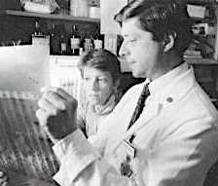
However, Taubenberger and his colleague Ann Reid had run into yet another problem. They had to face the possibility that there was not enough genetic material to reconstruct the virus. It was at this rather dismal point in time that fate (or rather Johan Hultin) intervened. In 1997, Hultin, who was then 72 years old wrote to Taubenberger about his expedition to Brevig in 1951.

Slide 28
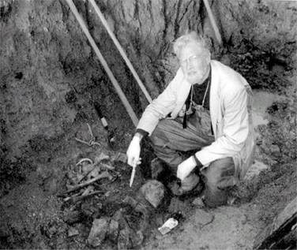
If at first you don’t succeed…
Long story cut short, Johan Hultin returned to Brevig in 1997 (with his wife’s pruning shears in hand to help him cut through bone). He reopened that long forgotten grave, and on the fourth day of digging discovered the body of a woman whose lungs were well preserved in the icy cold permafrost. He returned home with samples of her lungs and other organs and sent them to Taubenberger. The entire expedition took a sum total of ﬁve days.

Slide 29
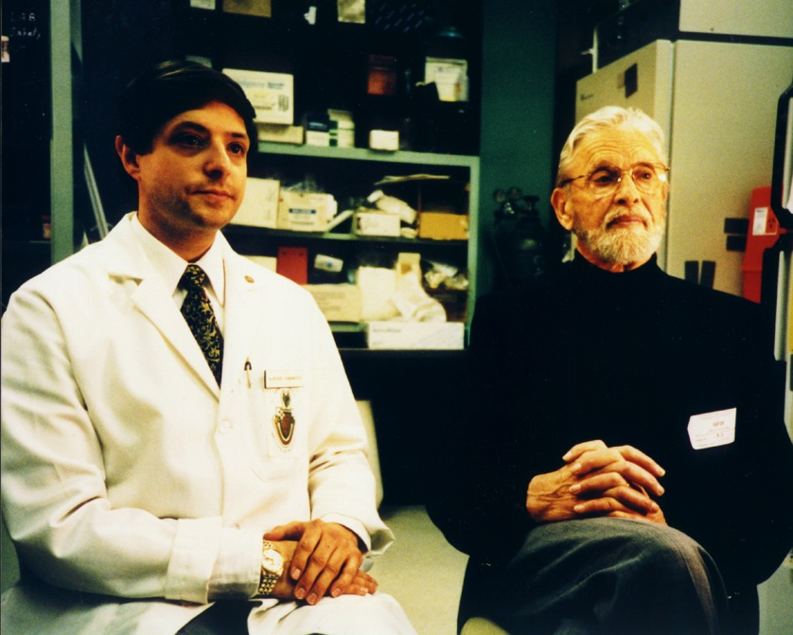

...then try again after 50 Years
"Ten days later, he called me," Hultin said of the conversation with Taubenberger. "I was in my Norwegian cabin in the mountains. 'We have the virus,' he said. I'd been waiting 50 years to hear that."

Slide 30
Watch the following video on the 1918 influenza:
http://video.pbs.org/video/1487943618/

Slide 31
CQ#11: In which type of organism do all
flu viruses originate?
Rats
Ferrets
Pigs
Birds

Slide 32
CQ#12a: Why was the 1918 influenza virus
so deadly to a certain population of people?
Because it killed very old people
Because it killed babies
Because it killed weak people
Because it killed strong healthy people
in the prime of their lives
CQ#12b: In your groups hypothesize why the 1918 virus killed this group of people. Find evidence to support your hypothesis and share your hypothesis with the class.

Slide 33

Reverse Engineering a Killer Virus
Lung specimen
Gene sequencing
Gene reconstruction
ATGCAAAGGG
Virus rescue
By combining reverse genetics with other molecular techniques it was possible to reverse engineer the 1918 virus to find clues to deciphering how the virus spread & killed and ultimately find a way to cripple the virus.

Slide 34

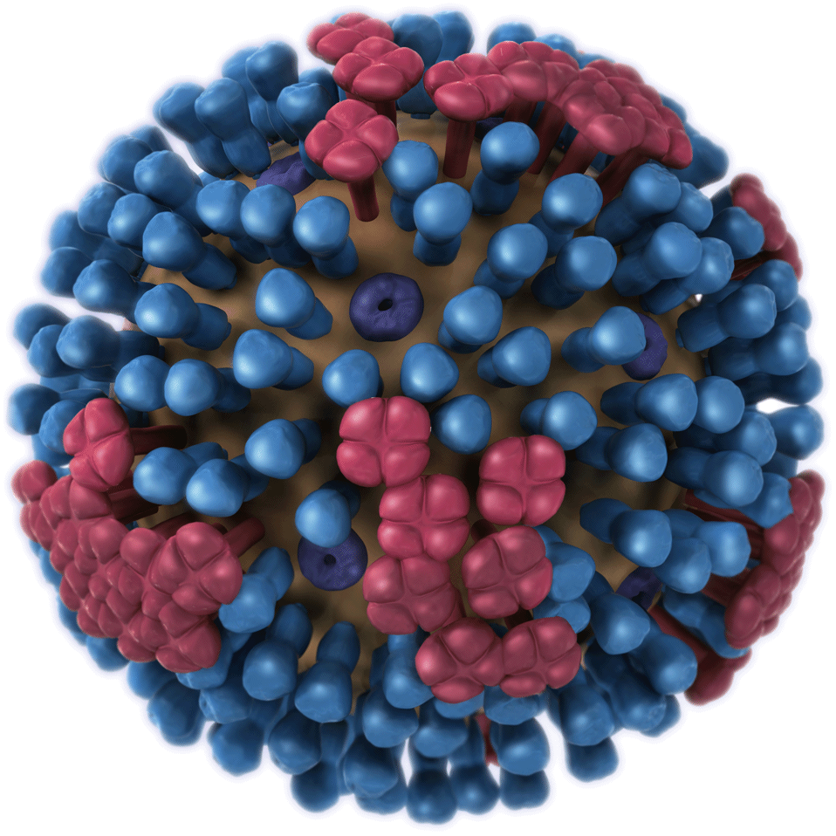
This method of building ﬂu-virus particles from its genetic code is called "reverse genetics”. This entails looking at a gene to ﬁgure out its function, rather than the other way around.

Slide 35
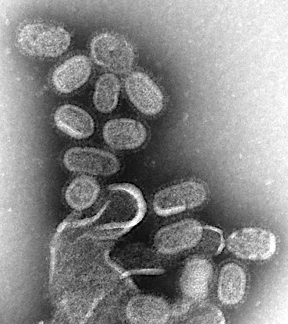
Building a Virus from Spare Parts….
It is possible to synthesize DNA/RNA using the the virus's sequenced genetic code. When placed in solution, the viral genetic material can assemble into longer pieces with the help of enzymes which can be inserted into a circle of DNA called a plasmid

Slide 36
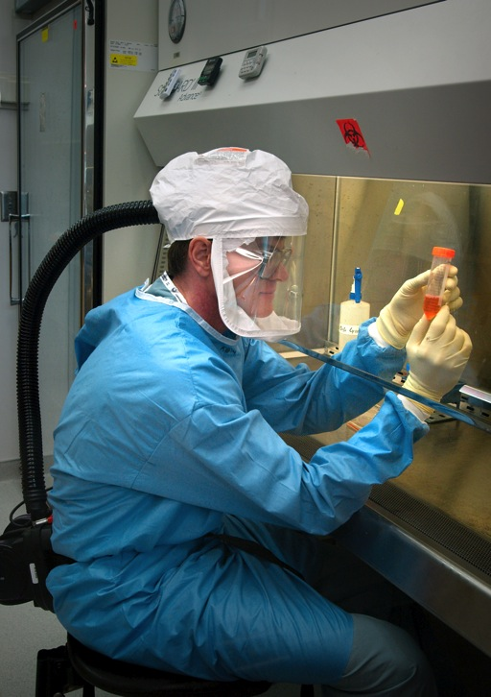
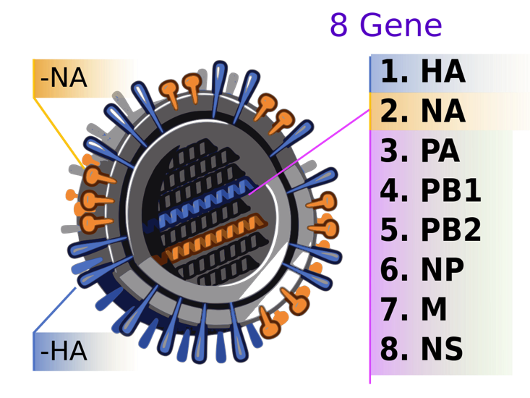
If you have plasmids containing all eight ﬂu virus RNA segments, it is a fairly simple matter to transfect them along with a few other components into a cell and recreate the virus in cells. This is exactly what scientist Terrence Tumpey accomplished in his laboratory.

Slide 37
Reverse-genetics system for generation of influenza viruses from plasmids
Transfection
293T/MDCK Cells
8 plasmids expressing
viral RNAs expressed
from pol I vectors.
4 protein-expression plasmids
for viral polymerase and
proteins expressed from
pol I vectors.
Recombinant influenza virus
Modified from Fodor E, et. al. (1999) J. Virol. 73: 9679-9682.

Slide 38
CQ#13: How many RNA segments does the flu
virus have?
12
6
8
300

Slide 39
CQ#14a: Is is possible to synthesize viral
genetic material using the information from
the sequenced genes of the virus?
Yes
No
CQ#14b: Discuss in your groups how
‘reverse’ genetics may be able to help
people with other diseases. Jot down a few
ideas then use the internet to find out if
any of your ideas are actually being applied.

Slide 40
It had taken nearly 50 years to ﬁnd a tiny trace of the 1918 virus in preserved tissue, and nearly 10 years for Taubenberger to sequence its genetic material. However, it took mere months to transform the code into actual genes, and Tumpey just a few days to produce viable virus particles.

Slide 41
Resurrecting a Serial Killer
The entire team was well aware that bringing such a lethal pathogen back into the world was going to cause a lot of controversy. However, a virus descended from the 1918 virus has been in the human population since 1977 so the group was fairly conﬁdent that everyone carried at least partial immunity to the once lethal 1918 virus.

Slide 42
CQ#15: Why was the team confident that
the 1918 virus would not be as deadly in the
human population today?
Because they did not resurrect it correctly
Because it had mutated
Because the human population carried
partial immunity to the virus
D. Because they had a gut feeling that it was
no longer dangerous

Slide 43
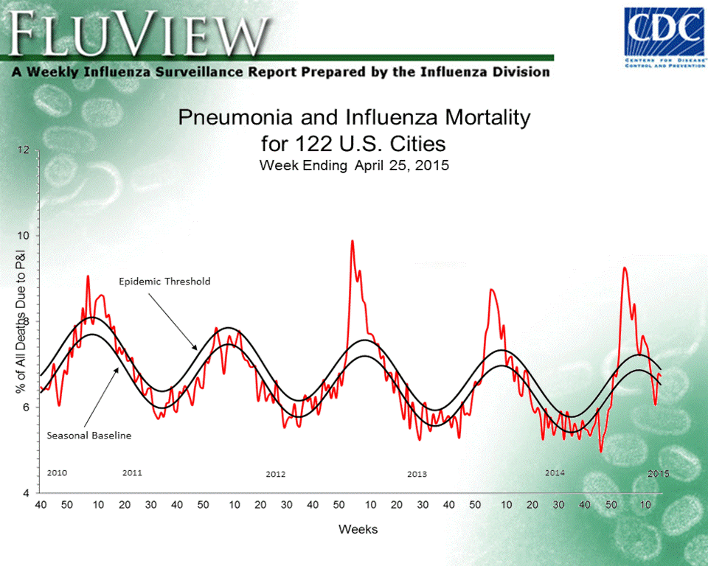
CQ#16a: From the data in the graph, in which
year/week was mortality higher?
2012 week 10
2013 week 4

Slide 44
CQ#16b: Use the following link to go to the FluView websitehttp://www.cdc.gov/flu/weekly/fluactivitysurv.htm.
In your groups navigate the FluView website and look at the data for the current year/season and compare the current Flu season to the previous year/ season. Compare the mortality rates and hospitalization rates for both years and hypothesize why they are similar or different.

Slide 45
Fact or Fiction?

Slide 46
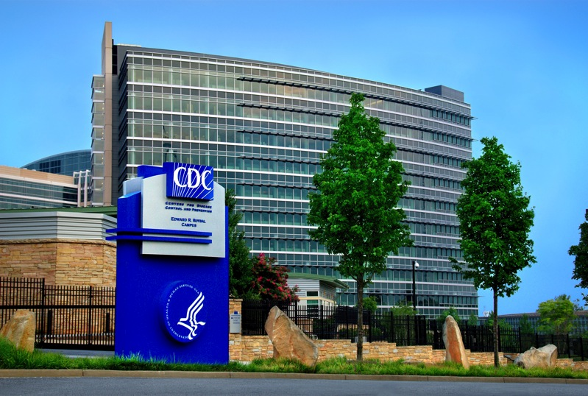
One morning a mysterious hooded figure walked into Centers for Disease Control and Prevention in Atlanta. He took the elevator up to an undisclosed level and walked through a security door with a stolen ID card. He took off all his clothes, pulled on cotton scrubs, a disposable gown, two pairs of latex gloves and protective headgear with a set of ﬁlters strapped to his waist. He walked through another door and down a hallway to a large upright freezer mounted with a retinal scanner.

Slide 47

He whipped out his cell phone and positioned a photograph of an eye onto the lens of the scanner. "Identiﬁcation conﬁrmed," the scanner said, and the lock on the freezer clicked open. Inside the freezer were hundreds of trays and boxes containing various select agents - highly pathogenic and lethal microbes that under the Patriot Act cannot be handled without special clearance from the Department of Justice. The man smiled and got to work removing the trays and boxes from the freezer……

Slide 48
Further Reading
Kolata, G. (2001). Flu: the story of the great influenza pandemic of 1918 and the search for the virus that caused it. Simon and Schuster.
Taubenberger, J. K., Baltimore, D., Doherty, P. C., Markel, H., Morens, D. M., Webster, R. G., & Wilson, I. A. (2012). Reconstruction of the 1918 influenza virus: unexpected rewards from the past. MBio, 3(5), e00201-12.
Shreeve, J. (2006). Why revive a deadly flu virus. New York Times, 29.
Reid, A. H., Fanning, T. G., Hultin, J. V., & Taubenberger, J. K. (1999). Origin and evolution of the 1918 “Spanish” influenza virus hemagglutinin gene. Proceedings of the National Academy of Sciences, 96(4), 1651-1656.
Tumpey, T. M., Basler, C. F., Aguilar, P. V., Zeng, H., Solórzano, A., Swayne, D. E., ... & Garcia-Sastre, A. (2005). Characterization of the reconstructed 1918 Spanish influenza pandemic virus. Science, 310(5745), 77-80.

Slide 49
Image Credits
Slide 1.
Description: Picture of an influenza virus
Source: The Centers for Disease Control
Link: http://www.cdc.gov/flu/images.htm
Clearance: Public domain
Slides 2 and 14.
Description: Photograph of young scientist working in a laboratory
Spurce: CDC presentation
Clearance: Public domain
Slide 3.
Description: The science laboratory at Aspatria Agricultural College, circa 1890
Link: https://commons.wikimedia.org/wiki/File:The_Science_Laboratory.jpg
Clearance: Public domain
Slides 4 and 31.
Description: The Spanish Influenza. Emergency military hospital during influenza epidemic, Camp Funston, Kansas, United States.
Link: https://commons.wikimedia.org/wiki/File:Spanish_flu_hospital.png
Clearance: Creative Commons Attribution 2.5 Generic license.
Slide 12.
Description: Teller Reindeer Station headquarters. Photo by S. J. Call, U.S.R.M. 1894.
Link: https://commons.wikimedia.org/wiki/File:Teller_Reindeer_Station_headquarters.png
Clearance: Public domain.
Slide 13.
Description: Digging up graves in Alaska ( a young Johan Hultin in 1951, Brevig, Alaska)
Source: CDC presentation
Clearance: Public domain

Slide 50
Slide 16.
Description: Timeless books
Source: Wikimedia commons
Link: http://upload.wikimedia.org/wikipedia/commons/d/d6/Timeless_Books.jpg
Clearance: Creative commons license 2.0
Slide 18
Description: Frisco
Source: Wikimedia commons
Link: http://upload.wikimedia.org/wikipedia/commons/4/45/Back_to_FRISCO_%284734975172%29.jpg
Clearance: Creative commons license 2.0
Slides 18 and 30.
Description: Log cabin in Norway.
Source: Wikimedia commons.
Link: https://commons.wikimedia.org/wiki/File:DNT_Fogdehytta_i_%C3%98verbymarka_p%C3%A5_Gj%C3%B8vik.JPG
Clearance: Creative Commons Attribution-Share Alike 3.0 Unported license.
Slides 19, 26, 33, 34, 46.
Description: Generic influenza virus
Source: CDC website
Link: http://www.cdc.gov/flu/images/h1n1/3D_Influenza_transparent_no_key_full_lrg.gif
Clearance: Public domain
Slide 19, 20, 24.
Description: Jeffery K. Taubenberger, M.D., Ph.D
Source: NIAID, NIH.
Link: http://www.niaid.nih.gov/LabsAndResources/labs/aboutlabs/lid/VPES/Pages/default.aspx
Clearance: Public domain.
Slides 20 and 33.
Description: Lung block tissue from a soldier in 1918.
Source:
Link:
Clearance:

Slide 51
Slides 27 and 29.
Description: Taubenberger and his colleague Ann Reid
Source: CDC presentation
Clearance: Public domain
Slides 28.
Desciption: Johan Hultin in 1997 at the Brevig gravesite
Source: CDC presentation
Clearance: Public domain
Slide 29.
Description: Johan Hultin and Jeffrey Taubenberger
Source: Armed Forces Institute of Pathology
Link: https://www.awesomestories.com/asset/view/Drs.-Taubenberger-and-Hultin-Search-for-Spanish-Flu-Virus
Clearance: Public domain.
Slide 34.
Description: DNA
Source: National Human Genome Research Institute
Link: http://commons.wikimedia.org/wiki/File:DNA_Cerchiato.png
Clearance: Public domain.
Slides 35, 40, 41.
Description: This negative stained transmission electron micrograph (TEM) shows recreated 1918 influenza virions that were collected from supernatants of 1918-infected Madin-Darby Canine Kidney (MDCK) cells cultures 18 hours after infection.
Source: The Centers for Disease Control
Link: https://commons.wikimedia.org/wiki/File:EM_of_influenza_virus.jpg
Clearance: Public domain

Slide 52
Slide 36.
Description: Influenza virus H1N1
Source: Wikkimedia commons
Link: https://commons.wikimedia.org/wiki/File:2009_H1N1_influenza_virus_genetic-num.svg
Clearance: Public domain
Slide 36.
Description: Terrence Tumpey in the lab
Source: CDC
Clearance: Public domain.
Slide 37.
Description: Reverse-genetics system for generation of influenza viruses from plasmids
Source: Modified from Fodor E, et. al. (1999) J. Virol. 73: 9679-9682.
Clearance: Copyright © 1999 American Society for Microbiology.
Slide 43.
Description: Flu View graph
Source: CDC website
Link: http://www.cdc.gov/flu/weekly/#S1
Clearance: Public domain.
Slide 46
Description: The Centers for Disease Control, Atlanta, GA
Source: Wikimedia commons
Link: http://commons.wikimedia.org/wiki/File:CDC_Headquarters_PHIL_10693.tif
Clearance: Public domain.

Slide 53
References
Shreeve, J. (2006). Why revive a deadly flu virus. New York Times, 29.
Kolata, G. (2001). Flu: the story of the great influenza pandemic of 1918 and the search for the virus that caused it. Simon and Schuster.
Fodor, E., Devenish, L., Engelhardt, O. G., Palese, P., Brownlee, G. G., & García-Sastre, A. (1999). Rescue of influenza A virus from recombinant DNA. Journal of virology, 73(11), 9679-9682.

