Slide 1
Civic Virtue Starts at Home: Faith and Freedom for Institutional Transformation Remarks for the Lilly Fellows Conference University of Scranton October 19, 2013
President Patricia McGuire
Trinity Washington University
Washington, DC

Slide 2
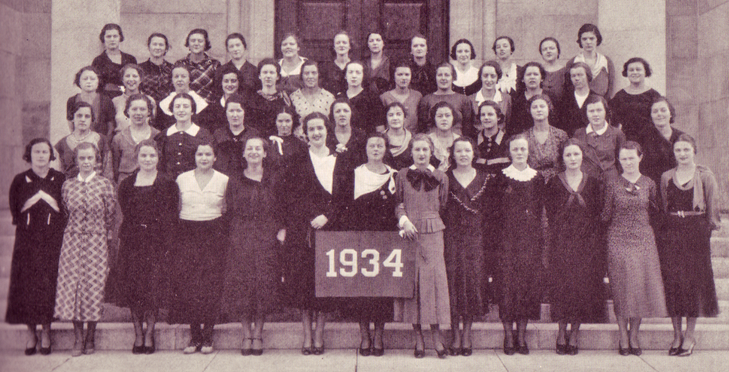
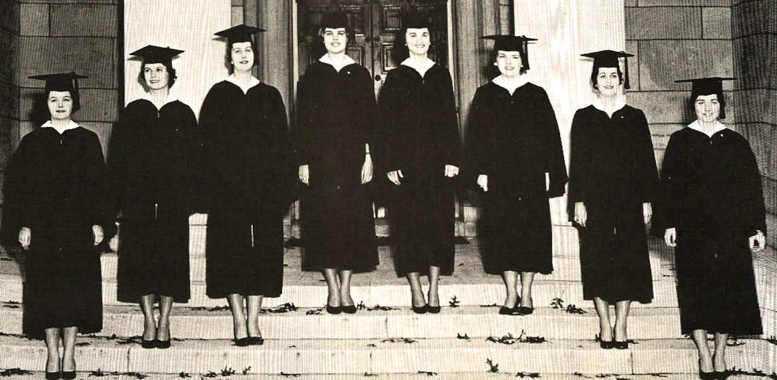
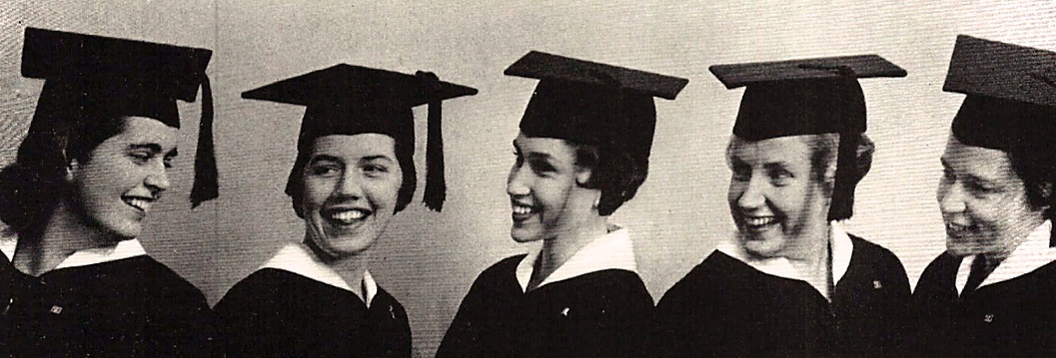
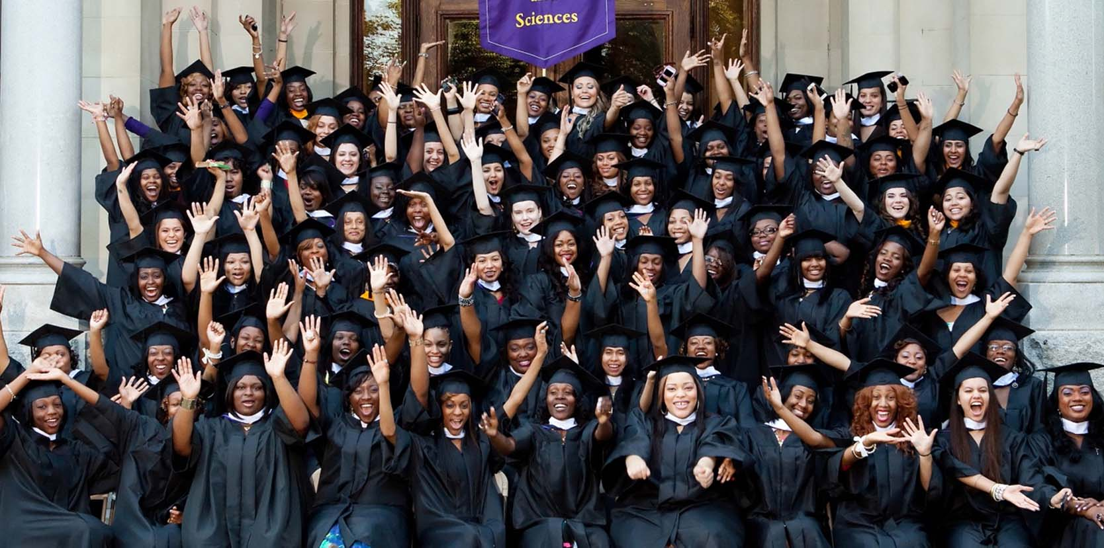
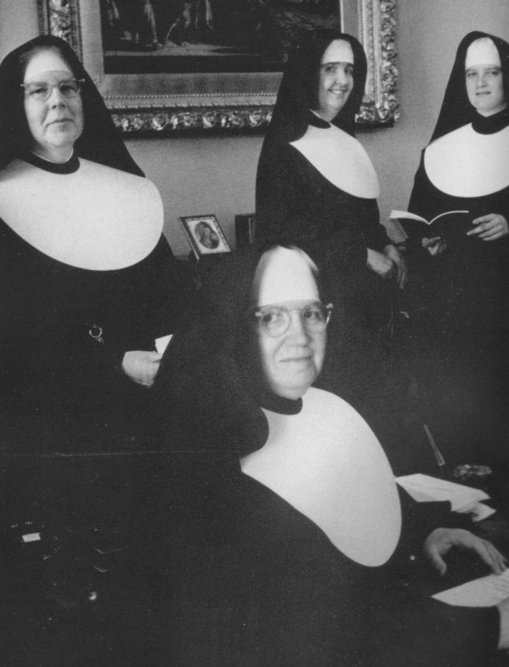

Slide 3
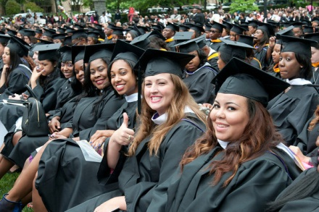
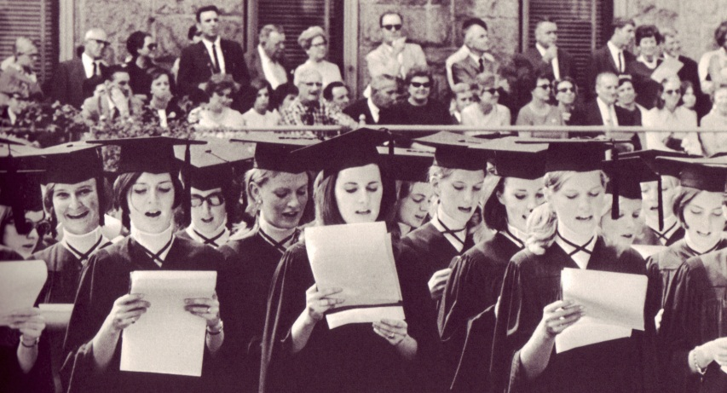
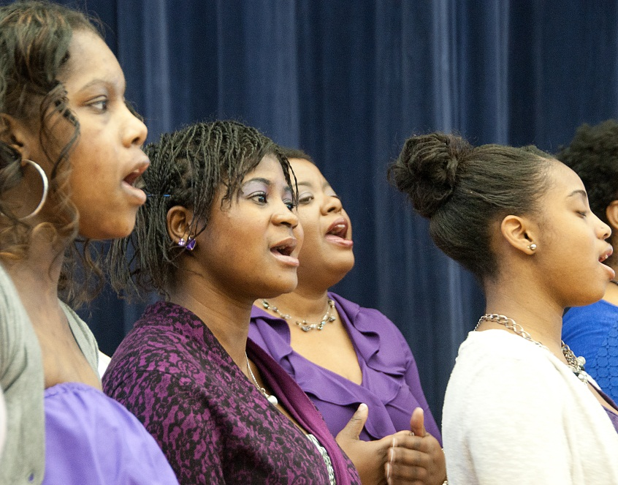
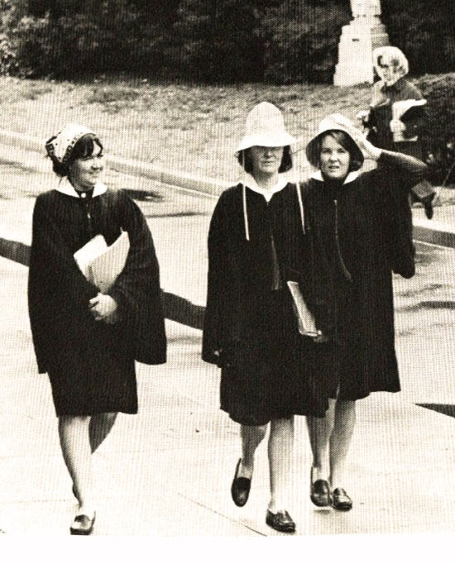
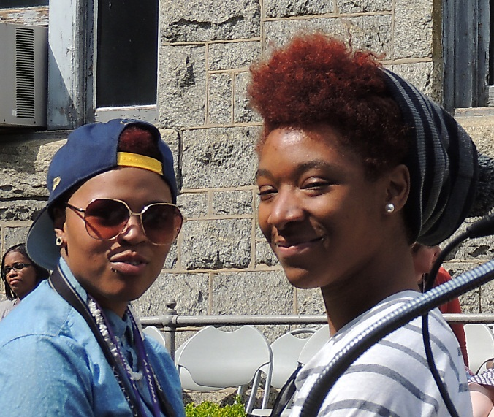
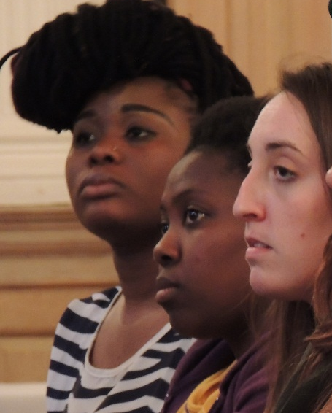

Slide 4
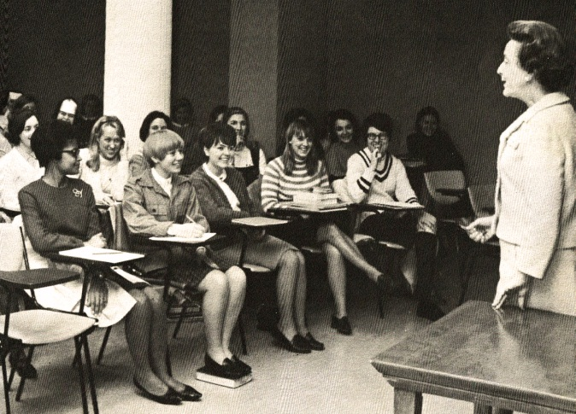
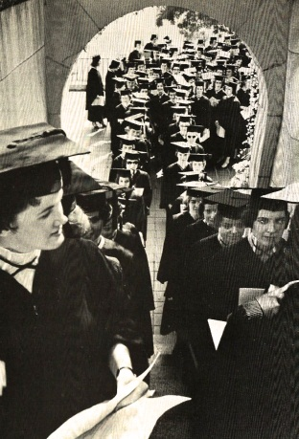
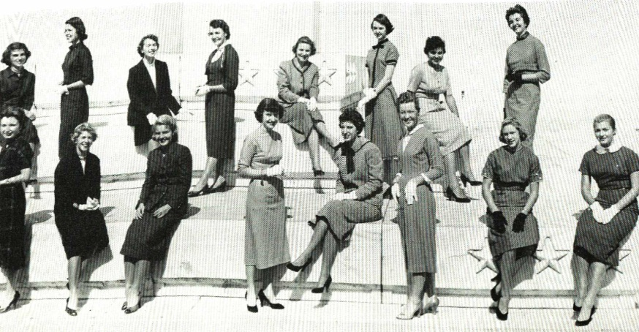
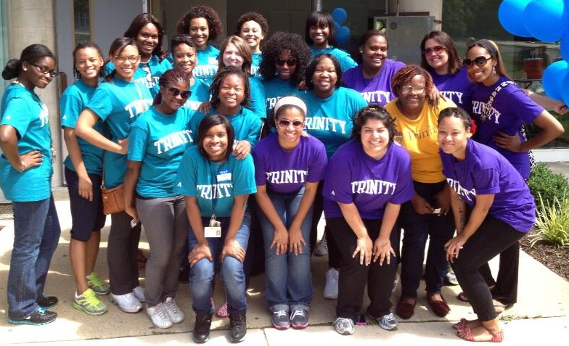
“We need to proclaim the Gospel on every street corner…”
Pope Francis I

Slide 5
“There is not a religion, a philosophy, a science, an art for man and another for woman. Consequently, there is not, in its essential elements at least, an education for man and another for woman. In souls, in minds, in consciences, in hearts, there is no sex. What is the best education for woman? That which will best help her to become a perfect human being, wise, loving and strong. What is her work? Whatever may help her to become herself. What is forbidden her? Nothing but what degrades or narrows or warps. What has she the right to do? Any good and beautiful and useful thing….” (Bishop John Lancaster Spalding, Means and Ends of Education, 1895)

Slide 6
Trinity’s enrollment of full-time traditional undergraduates grew
from 19 students on opening day in 1900
to the peak in 1968 at 966 students.

Slide 7
From a high of 966 students in 1968,
Trinity’s full-time undergraduate enrollment
declined to 323 in 1993. This still all-female population
is now enrolled in the College of Arts and Sciences

Slide 8
Sweeping Forces of Change
Vatican II
Catholics more accepted outside of Catholic schools
Declining vocations, end of Contributed Services
Laicization of Boards
Sputnik, Space Race, NSF
Men’s universities grew, especially science and technology, women’s colleges largely left out
Coeducation
Civil Rights and Women’s Rights Movements
NCAA and big time college sports
Title IX

Slide 9
“Why are we trying so hard to “reclaim” a population that has moved on? The SNDs founded Trinity to offer access to higher education for women who face barriers. There are thousands of women at our doorstep who still face huge barriers, who need a Trinity education so very much” --- a Sister of Notre Dame during strategic planning discussions circa 1992

Slide 10
Trinity Mission Statement
Trinity is a comprehensive university offering a broad range of educational programs that prepare students across the lifespan for the intellectual, ethical and spiritual dimensions of contemporary work, civic and family life.
Trinity’s core mission values and characteristics emphasize:
Commitment to the Education of Women in a particular way through the design and pedagogy of the historic undergraduate women’s college, and by advancing principles of equity, justice and honor in the education of women and men in all other programs;
Foundation for Learning in the Liberal Arts through the curriculum design in all undergraduate degree programs and through emphasis on the knowledge, skills and values of liberal learning in all graduate and professional programs;
Integration of Liberal Learning with Professional Preparation through applied and experiential learning opportunities in all programs;
Grounding in the mission of the Sisters of Notre Dame de Namur and the Catholic tradition, welcoming persons of all faiths, in order to achieve the larger purposes of learning in the human search for meaning and fulfillment.

Slide 11
TRINITY STRATEGIC PARADIGM 2013
SCHOOL OF
EDUCATION
-------------------------------------------------
TEACHER PREP, SCHOOL ADMIN
AND COUNSELING PROGRAMS
COEDUCATIONAL
EVENING AND WEEKEND
POSTGRADUATE PROFESSIONAL
DEVELOPMENT PROGRAMS
SCHOOL OF
PROFESSIONAL
STUDIES
-----------------------------------
PROFESSIONAL PROGRAMS
FOR WORKING STUDENTS
COEDUCATIONAL
EVENING AND WEEKEND
ON AND OFF-SITE
ONLINE AND CLASSROOM
COLLEGE OF
ARTS & SCIENCES
--------------------------------------------
WOMEN’S COLLEGE
WEEKDAY/FULL-TIME
LIBERAL ARTS
BACCALAUREATE
ATHLETICS
CO-CURRICULAR
LEARNING PROGRAMS
SCHOOL OF NURSING AND HEALTH PROFESSIONS
________________________
COED
NURSING BAC + MASTERS
OT, PT, OTHER

Slide 16
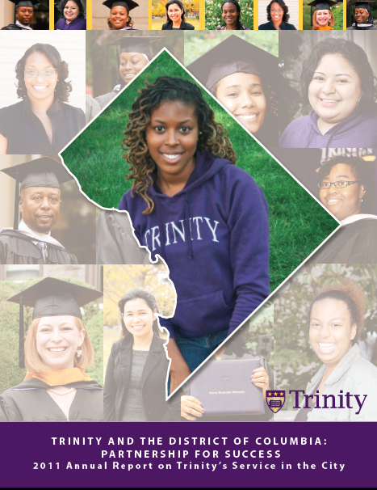

Slide 17
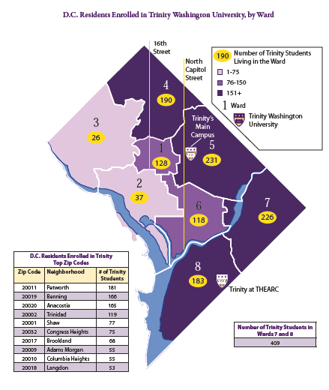

Slide 18
“The team recognizes the impressive congruence of Trinity in 2006 with the original vision of Trinity’s founders in 1897. “The team admires and commends the University’s rejection of the notion that paradigm shift means abandonment of historic mission. “Rather, we discover in the work and vitality of Trinity of 2006, a most obvious continuity with Trinity’s 110 year old mission expressed with a renewed relevance and vigor….” (2006 Middle States Team Report for Trinity, p. 5)

Slide 19
“32. A Catholic University…is called on to become an ever more effective instrument of cultural progress for individuals as well as for society. Included among its research activities, therefore, will be a study of serious contemporary problems in areas such as the dignity of human life, the promotion of justice for all, the quality of personal and family life, the protection of nature, the search for peace and political stability, a more just sharing in the world's resources, and a new economic and political order … If need be, a Catholic University must have the courage to speak uncomfortable truths which do not please public opinion, but which are necessary to safeguard the authentic good of society.” (Ex Corde Ecclesiae)

Slide 20
“34. The Christian spirit of service to others for the promotion of social justice is of particular importance for each Catholic University…The Gospel, interpreted in the social teachings of the Church, is an urgent call to promote "the development of those peoples who are striving to escape from hunger, misery, endemic diseases and ignorance; of those who are looking for a wider share in the benefits of civilization and a more active improvement of their human qualities; of those who are aiming purposefully at their complete fulfillment"(33). Every Catholic University feels responsible to contribute concretely to the progress of the society within which it works: for example it will be capable of searching for ways to make university education accessible to all those who are able to benefit from it, especially the poor or members of minority groups who customarily have been deprived of it. ...” (Ex Corde Ecclesiae)

Slide 21
Trinity Initiatives for Social Justice
Dreamers: Trinity is partnering with a new organization in development of a scholarship program to support undocumented students in college
Community Support: Trinity extends a broad range of services and hospitality upon request to local community residents and civic leaders; Trinity students, faculty and staff donate on average more than 50,000 hours of service to the community each year
Peacebuilding: Trinity faculty and students participate each year in programs of the Capital Area Association of Peace Studies (CAAPS), and Trinity students, faculty and staff also engaged actively with the 50th Anniversary of Pacem in Terris conferences
Environmental Stewardship: Trinity participates routinely in recycling and environmental stewardship planning for campus facilities; Students actively pursue environmental action on campus; Dr. Diana Watts of the Business Administration faculty emphasizes sustainability and “green business” while Dr. Shizuki Hsieh in Chemistry pursues research on pollution in Ivy City

Slide 22
Trinity Initiatives: Billiart Center for Social Justice
Named for St. Julie Billiart, founder of the Sisters of Notre Dame de Namur, the Billiart Center for Social Justice rests on four pillars: scholarship, spirituality and religiosity, and service – pillars on which the identity of Trinity rests as well. The Center explores contemporary local, national and international social and economic issues which affect the lives of women, particularly in the religious and political spheres. The programs offered by the Billiart Center build on the many ways in which these themes already are explored in Trinity’s curricula and extracurricular activities. This Center is a central place that gathers and encourages what is already being done and offers assistance in developing more programs and ideas.
Programs offered through the Billiart Center in Fall 2013 include:
The Sociology of the Papacy: Pope Francis’ Transformative Role (Sr. Mary Johnson, SND, Distinguished Professor of Sociology and Religious Studies)
Poverty in the United States (Sr. Marge Clark, NETWORK)
Action for Justice at the United Nations (Sr Jean Stoner, SND, liaison for the SND NGO at the United Nations)
Soup with the Sisters: a periodic gathering of students, faculty and staff with the SND community on campus to reflect on women’s spirituality and issues of concern to women

Slide 23
Trinity Initiatives: Campus Ministry
With the leadership of Sr. Mary Ellen Dow, SND, the Campus Ministry program offers a wide range of opportunities for prayer and worship, spiritual development and active engagement with social justice through community service. Some of the programs conducted through Campus Ministry include:
Alternative Spring Break in Selma: A select group of Trinity students spend the spring semester studying issues of justice and leadership, with a capstone experience during spring break in Selma, Alabama working with the Blackbelt Housing Coalition on housing rehab, and also tracing the historic steps of civil rights leaders
Cunneen Fellowship: Trinity students receive generous fellowships for summer work in community service sites, with academic preparation and required summative papers to ensure the full learning experience
Sower’s Seed Lecture: Supported by a generous gift from an alumna, the Sower’s Seed lecture is an annual program to engage an alumna leader involved with in service and justice work for a week long exploration of issues related to her work including a lecture for the campus community
Weekly Service Programs: Students, faculty and staff have weekly opportunities to perform needed service with community organizations such as the Capital Area Food Bank and Christ House

Slide 24
Trinity Initiatives: Sciences and Mathematics
Trinity’s faculty and students the sciences and mathematics are engaging with critical issues in the Washington community in numerous ways:
Ivy City Air Quality Study: Dr. Shizuka Hsieh of Chemistry is conducting research with colleagues at area universities to collect data on air pollution in Ivy City, an impoverished section of northeast D.C. with significant bus traffic . This project also presents undergraduate research opportunities for Trinity students. Dr. Hsieh also focuses on environmental justice in her CHEM 101 courses, and her approach takes the students through a global view of environmental challenges from air pollution in China to lead poisoning in Senegal.
Dr. Sita Ramamurti, professor of Mathematics, is spending her sabbatical year at the Maya Angelou Public Charter School working with teachers on a model program to enhance their capacity to teach to the mathematics expectations in the Common Core curriculum. Maya Angelou serves acutely low income students in the most impoverished section of D.C.; Maya Angelou students have often been unsuccessful in other schools. The school is part of the larger network of schools and programs organized through the See Forever Foundation.
Access to the STEM disciplines for low income African American and Latina women in D.C. is a clear emphasis of Trinity’s entire science and mathematics curriculum and co-curricular programming.

Slide 25
Trinity Initiatives: Sociology
Courses in Sociology typically embed a broad range of social justice considerations, and many of these courses also require service learning. Some examples include
Understanding AIDS: students created a poster project for display on campus presenting data on prevalence, transmission, testing, affected populations and other dimensions of HIV/AIDS
Inequality and Society: examines issues of income and wealth distribution, poverty and the effects of social class, gender and race/ethnicity on social inequality in the United States
Senior Seminar Requirements: students engage with community organizations focused on issues of economic, ethnic and gender inequality, working with organizations such as Bread for the City, N Street Village serving low income women, My Sisters Place, Beacon House and other organizations serving critical needs in the city

Slide 26
Trinity Initiatives: School of Education
Students and faculty in Trinity’s School of Education are actively engaged in projects, curricula and programs designed for urban communities that have high levels of poverty, educational marginalization, a prevalence of students with disabilities needing specific services, immigrant populations, and issues related to race, gender, sexual orientation, language, national origin and religion, among others. Topics in the Spring 2013 Research Colloquium presenting student and faculty papers illustrate this engagement:
Secondary Education
The effect of Black male teachers on the behavior and performance of Black male students in Prince Georges County High Schools
Counseling Program
A qualitative study of home schooling among African American Families
Counseling El Salvadorian adolescents
Striving to achieve real world success (S.T.A.R.S.): a career development program for high school students with and without disabilities
Defying social norms of gay embodiment: the perceptive outlook on the male body and masculinity
Curriculum and Instruction – Educating for Change
Human consumption and a changing earth
Dr. Deborah Haskins, Program Director and Assistant Professor of Counseling, co-authored an article on “Human Flourishing: A Natural Home for Spirituality” in the Journal of Spirituality in Mental Health (volume 15, issue 3)

Slide 27
Trinity Initiatives: Nursing and Health Professions
Trinity’s faculty and students in Nursing, Occupational Therapy, Health Sciences, Exercise Science and related disciplines are engaged with a range of issues for healthcare in D.C. and the surrounding region. Examples:
Dr. Nancie Bruce, director of the RN-BSN program, is a member of the D.C. Action Coalition that seeks to address problems with disparity in access to excellent health care in the Washington region, particularly for impoverished populations
Two Nursing courses (320: Policy and Politics in Nursing; 325: Contemporary Issues in Nursing and Health Care) specifically focus on problems in healthcare delivery and public policy issues

Slide 28
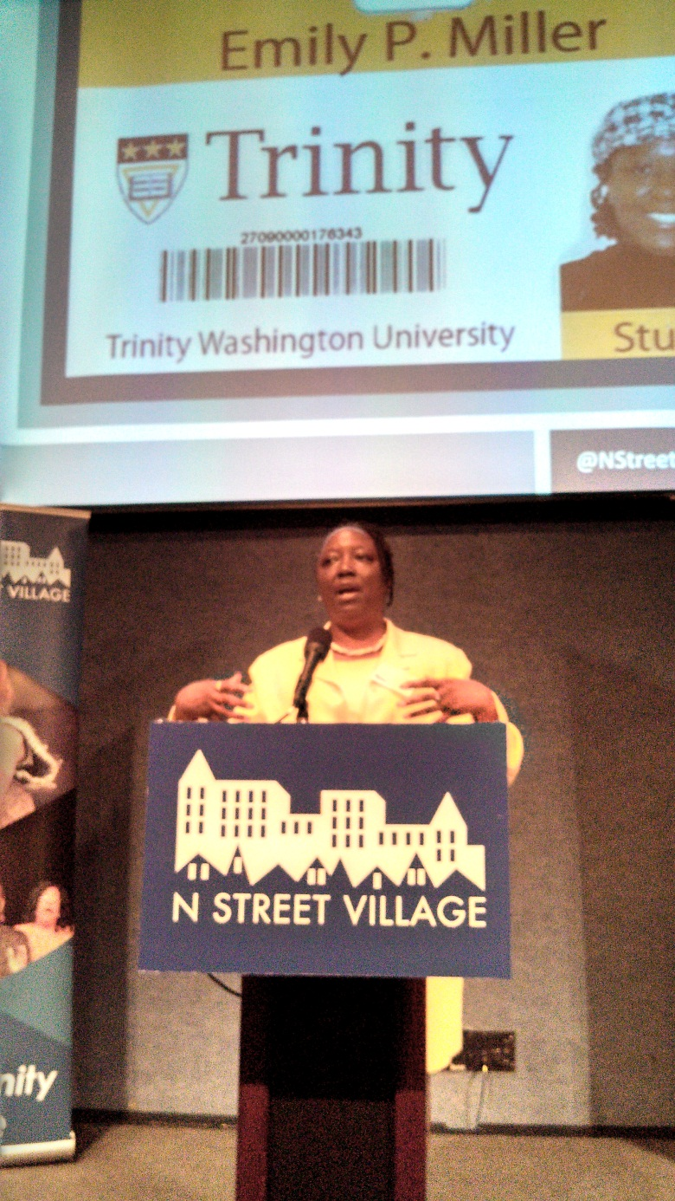
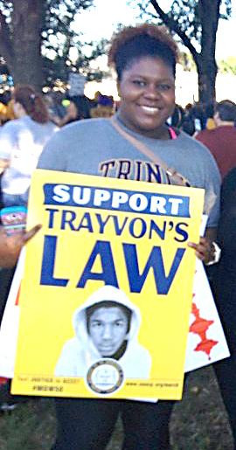
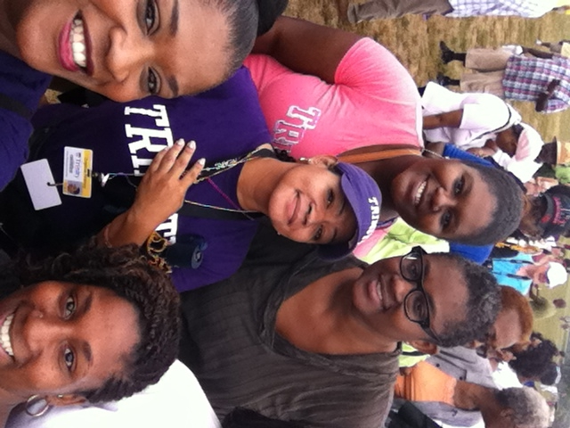
“No one is saved alone, as an isolated individual, but God attracts us looking at the complex web of relationships that take place in the human community. God enters into this dynamic, this participation in the web of human relationships....” Pope Francis I, Interview in America Magazine, September 30, 2013

Slide 29
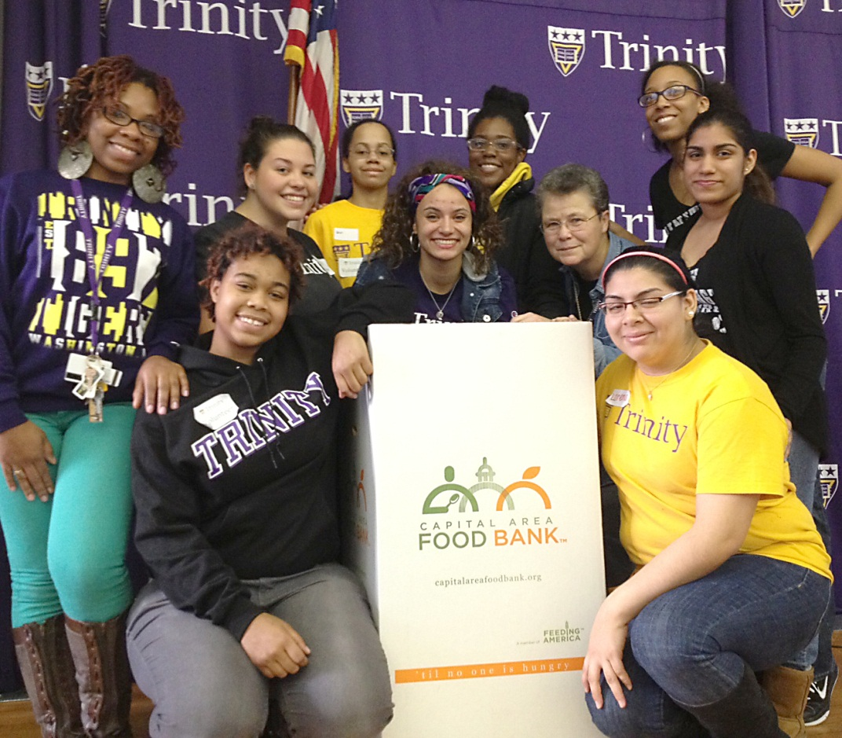
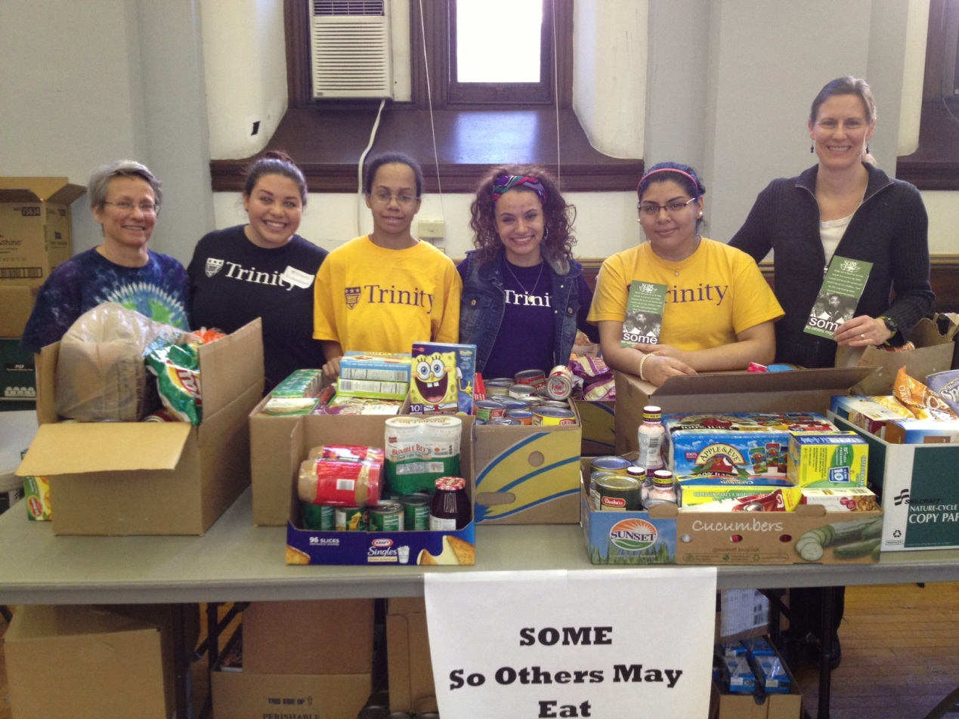
“I see the holiness,” the pope continues, “in the patience of the people of God: a woman who is raising children, a man who works to bring home the bread, the sick, the elderly priests who have so many wounds but have a smile on their faces because they served the Lord, the sisters who work hard and live a hidden sanctity. This is for me the common sanctity. ...” Pope Francis I, Interview in America Magazine, September 30, 2013

Slide 30
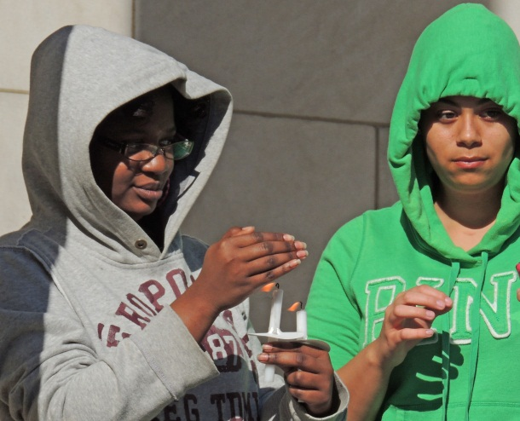
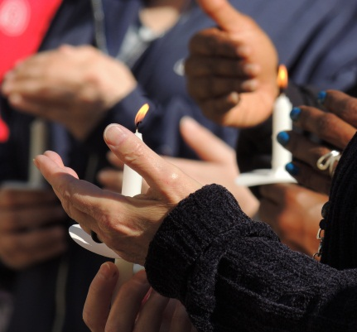
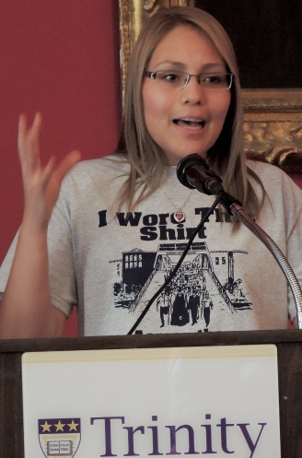
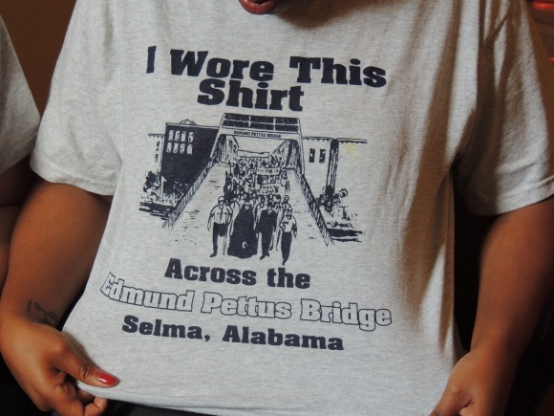
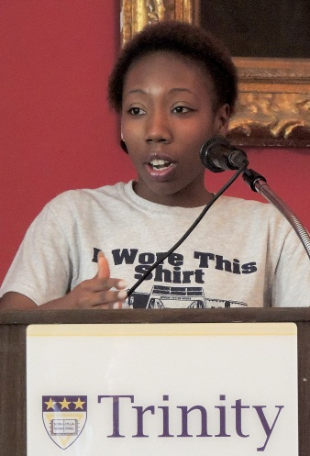
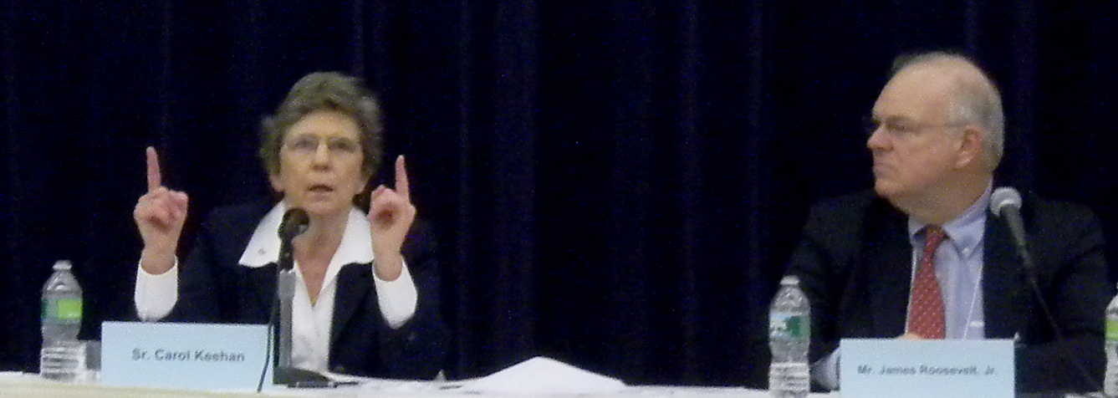
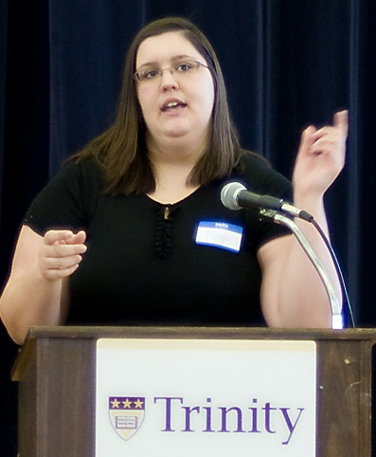
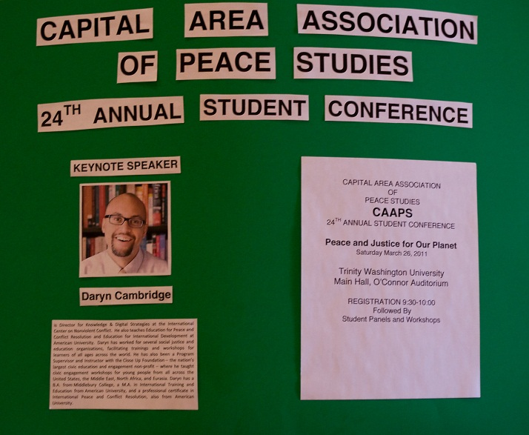
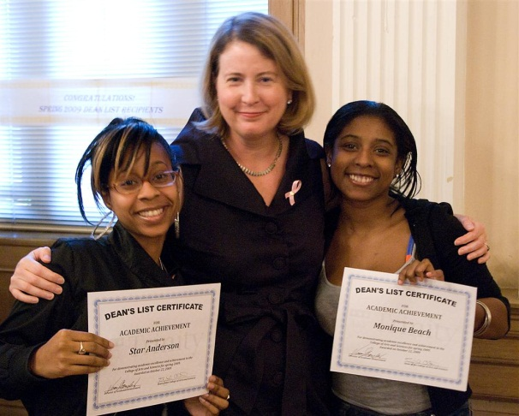
“How are we treating the people of God? I dream of a church that is a mother and shepherdess. The church’s ministers must be merciful, take responsibility for the people and accompany them like the good Samaritan, who washes, cleans and raises up his neighbor. This is pure Gospel. .... The ministers of the Gospel must be people who can warm the hearts of the people, who walk through the dark night with them, who know how to dialogue and to descend themselves into their people’s night, into the darkness, but without getting lost. ...” Pope Francis I, Interview in America Magazine, September 30, 2013

Slide 31
