Slide 1

President’s Report to Alumnae Reunion: June 1, 2013

Slide 2
Trinity Quick Facts 2013
ENROLLMENT
2,660 students enrolled in degree programs in four academic units:
  CAS: College of Arts & Sciences (Trinity College) full-time undergraduate women
  SPS: School of Professional Studies, part-time working professionals, coed, all degrees
  NHP: School of Nursing and Health Professions, coed, all degrees
  EDU: School of Education, coed, graduate degrees
14,000 alumnae and alumni
1000 undergraduate women in the College of Arts and Sciences
250 resident students/300 maximum housing capacity currently
90% African American, Latina, International students
70% Pell Grant Recipients
TOP MAJOR PROGRAMS
Undergraduate:
Human Relations Criminal Justice
Nursing Communications
Business Administration International Affairs
Psychology Biology
Graduate:
Business Administration Education
Communication Counseling
International Security School Leadership
TUITION AND FINANCIAL AID
$20,970 full-time undergraduate tuition (Fall 13)
$31,591 total full-time undergraduate cost/tuition-room-board-fees
40% discount rate (average Trinity grant of $8,000)
$520 per credit hour SPS undergraduate tuition
$670 per credit hour Nursing (NHP) tuition
$700 per credit hour graduate tuition
$740per credit hour MBA program
FINANCES
$35 million budget for Fiscal 2013
$12 million endowment
60% of budget = personnel costs
$1 million Annual Fund in Fiscal 2012
$15 million outstanding debt
All debt covenants met
HUMAN RESOURCES
75 full-time faculty and instructional staff
172 adjunct faculty
185 staff employees
$68,500 average 10-month faculty salary

Slide 3
Trinity Achievements
2012-2013
2,660 Enrollment!
1000+ in Trinity’s women’s college!
New Programs: Occupational Therapy, Forensic Science
Trinity Academic Center building design process underway
Second Century Campaign now @ $11.5 million cash/pledges!
Conway Scholarships for Nursing Students
Partnerships: KIPP, Cristo Rey Network
New Elevators in Main Hall!
New Restrooms on the Marble Corridor!
Strong Financial Foundation for Trinity’s Future!

Slide 4
Higher Education in 2013:
Disruption and Change
How is Trinity responding to these forces?

Slide 5

ACADEMICALLY
ADRIFT
SCANDALS
GRAD
RATES
JOB
MARKET
ATHLETICS
MOOCs
PELL
GRANTS
THE HIGHER EDUCATION BUBBLE
Moody’s
DEMOGRAPHICS
COLLEGE COST
TECH
ACCESS
ECONOMY
STUDENT
LOANS
AGING
FACULTY

Slide 6
National Center for Education Statistics: Forecast for Significant Demographic Changes in Enrollments in Higher Education
Projected Rates for College Enrollment Increases Nationally by 2021:
Race and Ethnicity
    42% Hispanic
    25% African American
    20% Asian
    4% White
Age:
    25% increase in students over-35
    20% increase in students age 25-35
    10% increase in students age 18-24
Gender:
    18% increase in women
    10% increase in men

Slide 7

In the last 25 years
Trinity has adapted to this changing environment with creativity and bold strategic plans…

Slide 8

We come together around a shared mission, vision and goals for Trinity…
Trinity Mission Statement
Trinity is a comprehensive university offering a broad range of educational programs that prepare students across the lifespan for the intellectual, ethical and spiritual dimensions of contemporary work, civic and family life.
Trinity’s core mission values and characteristics emphasize:
Commitment to the Education of Women in a particular way through the design and pedagogy of the historic undergraduate women’s college, and by advancing principles of equity, justice and honor in the education of women and men in all other programs;
Foundation for Learning in the Liberal Arts through the curriculum design in all undergraduate degree programs and through emphasis on the knowledge, skills and values of liberal learning in all graduate and professional programs;
Integration of Liberal Learning with Professional Preparation through applied and experiential learning opportunities in all programs;
Grounding in the mission of the Sisters of Notre Dame de Namur and the Catholic tradition, welcoming persons of all faiths, in order to achieve the larger purposes of learning in the human search for meaning and fulfillment.

Slide 9

STRATEGIC PLANNING DESIGN
STRATEGIC
ENROLLMENT
GOAL
(Goal 1)
BASELINE
5-YEAR
FINANCIAL
MODEL
(Goal 2)
CAPITAL
CAMPAIGN
PLAN
(Goal 2)
Enrollment Drivers
Financial Drivers
PROGRAMS
(Goal 3)
TECHNOLOGY
(Goal 4)
PEOPLE
CAPACITY
(Goals 5-6)
SERVICE
REPUTATION
INTELLECTUAL
OUTPUT
(Goals 7-8-9)
FACILITIES
(Goal 10)

Slide 10
TRINITY STRATEGIC PARADIGM
SCHOOL OF
EDUCATION
-------------------------------------------------
TEACHER PREP, SCHOOL ADMIN
AND COUNSELING PROGRAMS
COEDUCATIONAL
EVENING AND WEEKEND
POSTGRADUATE PROFESSIONAL
DEVELOPMENT PROGRAMS
SCHOOL OF
PROFESSIONAL
STUDIES
-----------------------------------
PROFESSIONAL PROGRAMS
FOR WORKING STUDENTS
COEDUCATIONAL
EVENING AND WEEKEND
ON AND OFF-SITE
ONLINE AND CLASSROOM
COLLEGE OF
ARTS & SCIENCES
--------------------------------------------
WOMEN’S COLLEGE
WEEKDAY/FULL-TIME
LIBERAL ARTS
BACCALAUREATE
ATHLETICS
CO-CURRICULAR
LEARNING PROGRAMS
SCHOOL OF NURSING AND HEALTH PROFESSIONS
________________________
COED
NURSING BAC + MASTERS
OT, PT, OTHER

Slide 11
10

Slide 12
NUMBER OF STUDENTS
2664
2555
2305
2034
1645
1637
1659
1640
1736
1618
1605
1327
11

Slide 13
KEY FACTORS SUPPORTING TRINITY’S GROWTH SINCE 1999
1999: MILLHISER CHALLENGE FOR TRINITY CENTER
2001: KRESGE CHALLENGE
2004: Centennial Campaign Concludes @ $12.2 million
2010: Academic Center Concept Design
2007: CAS NEW FIRST YEAR AND GEN ED
2003:
TRINITY CENTER OPENS
2000:
BOND ISSUE GROUNDBREAKING
CENTENNIAL ENDS
2006: NURSING PROGRAM BEGINS
2007-2010: OTHER NEW PROGRAM ELEMENTS: CRIMINAL JUSTICE, ISS, MOODLE PLATFORM XPANSION OF HYBRID OFFERINGS
2000: STRATEGIC PLAN “BEYOND TRINITY 2000” REORGANIZES TRINITY INTO THREE ACADEMIC UNITS
2004:
“UNIVERSITY” BECOMES PART OF TRINITY’S NAME
2006: STRATEGIC PLAN ‘ACHIEVING TRINITY 2010” DRIVES PROGRAMMATIC EXPANSION
2010: SCHOOL OF NURSIN G AND HEALTH PROFESSIONS
LAUNCHED
2002: START MODERNIZATION OF FINANCIAL SYSTEMS, IMPROVED FINANCIAL MANAGEMENT, CONVERSION OF INFORMATION PLATFORM
DC BON/CCNE accredit
2000:
DC TAG
DC CAP
NCATE first accreditation
Middle States Reaccreditation

Slide 14
33% growth projected 2013-2019
9%
0%
5%
6%
5%
3241
3055
2900
2835
2697
2641
2437
2565
2484

Slide 15
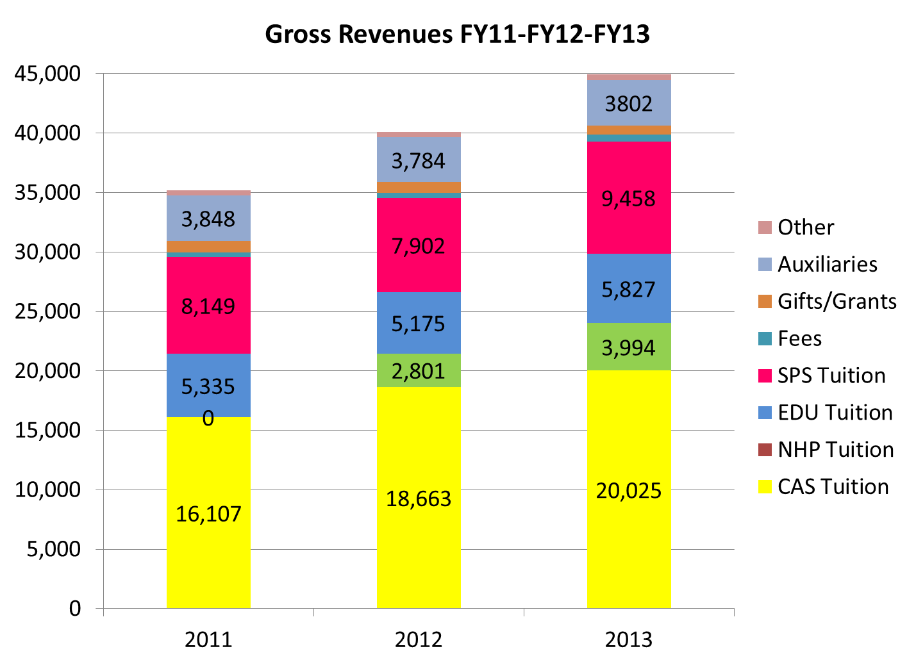

Slide 18
In all categories Trinity performs significantly better than the benchmark. For the first four categories, being higher than the benchmark is good. For the last category on the right, the tuition discount, being below the benchmark is good.

Slide 20
466
466
443
443
391
391

Slide 21
443 Graduates, 448 Majors

Slide 22
Survey of Recent Graduates 2002-2012:
Most are Pursuing More Education
60% enrolled in graduate school
31% have completed a grad degree and 23% are still enrolled in grad school
Grad Schools include:
  Georgetown - U. of Pennsylvania
  GWU - London School of Economics
  Hopkins - Howard U.
  American U - Drexel U.
  Howard U - TRINITY

Slide 23
Survey of Recent Graduates: Employment Overview
90% working or in grad school one year after graduation
Those not working or in grad school caring for families or pursuing other interests
Across 10 years 85% employed or in grad school, others caring for families or retired
Most employed in occupations related to majors
Top fields of work include Government, Healthcare, Nonprofits, Education (K-12), Business and Communication
Starting salaries averaged $40,000-$50,000
10 years out salaries avg $50,000-$60,000

Slide 24
Survey of Recent Graduates:
Most Important Skills Acquired at Trinity
Written Communication Skills – 92%
Critical Thinking Skills – 81%
Oral Communication Skills – 71%
Honesty and Integrity – 64%
Strong Work Ethic – 61%
Interpersonal Skills – 60%
Research Skills – 58%
Problem Solving, Teamwork – 53%

Slide 25
Some comments from recent grads:
I feel that the degree I received at Trinity is invaluable. I feel that I made the right decision to attend Trinity both for undergraduate and graduate. I had a rewarding experience.
Love, Love, Love. I even came back for grad school years later. There is honestly nothing like Trinity to me
I loved my time at Trinity. I love my Trinity degree. I believe that I am a better person because of my degree. I understand the value of my decisions and how they affect my environment and others. I understand the importance of social justice, even in 2013.
A college degree is now almost always required in my field. I would not have been able to increase my earning potential without my Trinity degree.
I enjoyed my work @ Trinity; if it weren't for Trinity, I'd still be taking classes @ geo. Mason part time, hoping to graduate someday.
My degree has opened many doors for me and empowered me to go as far professionally as i choose, but my degree and my time at Trinity also reminded me that i am responsible for my community.
Nursing program was wonderful the professors are really loving and dedicated to the students
I value my nine years of work at Trinity and believe it is extremely relevant to my work at my law firm job. The academic environment was deeply supportive and the teachers were excellent. Even though I was older, I value this part of my life so much and believe it has made me a more diverse and evolved human being.

Slide 26
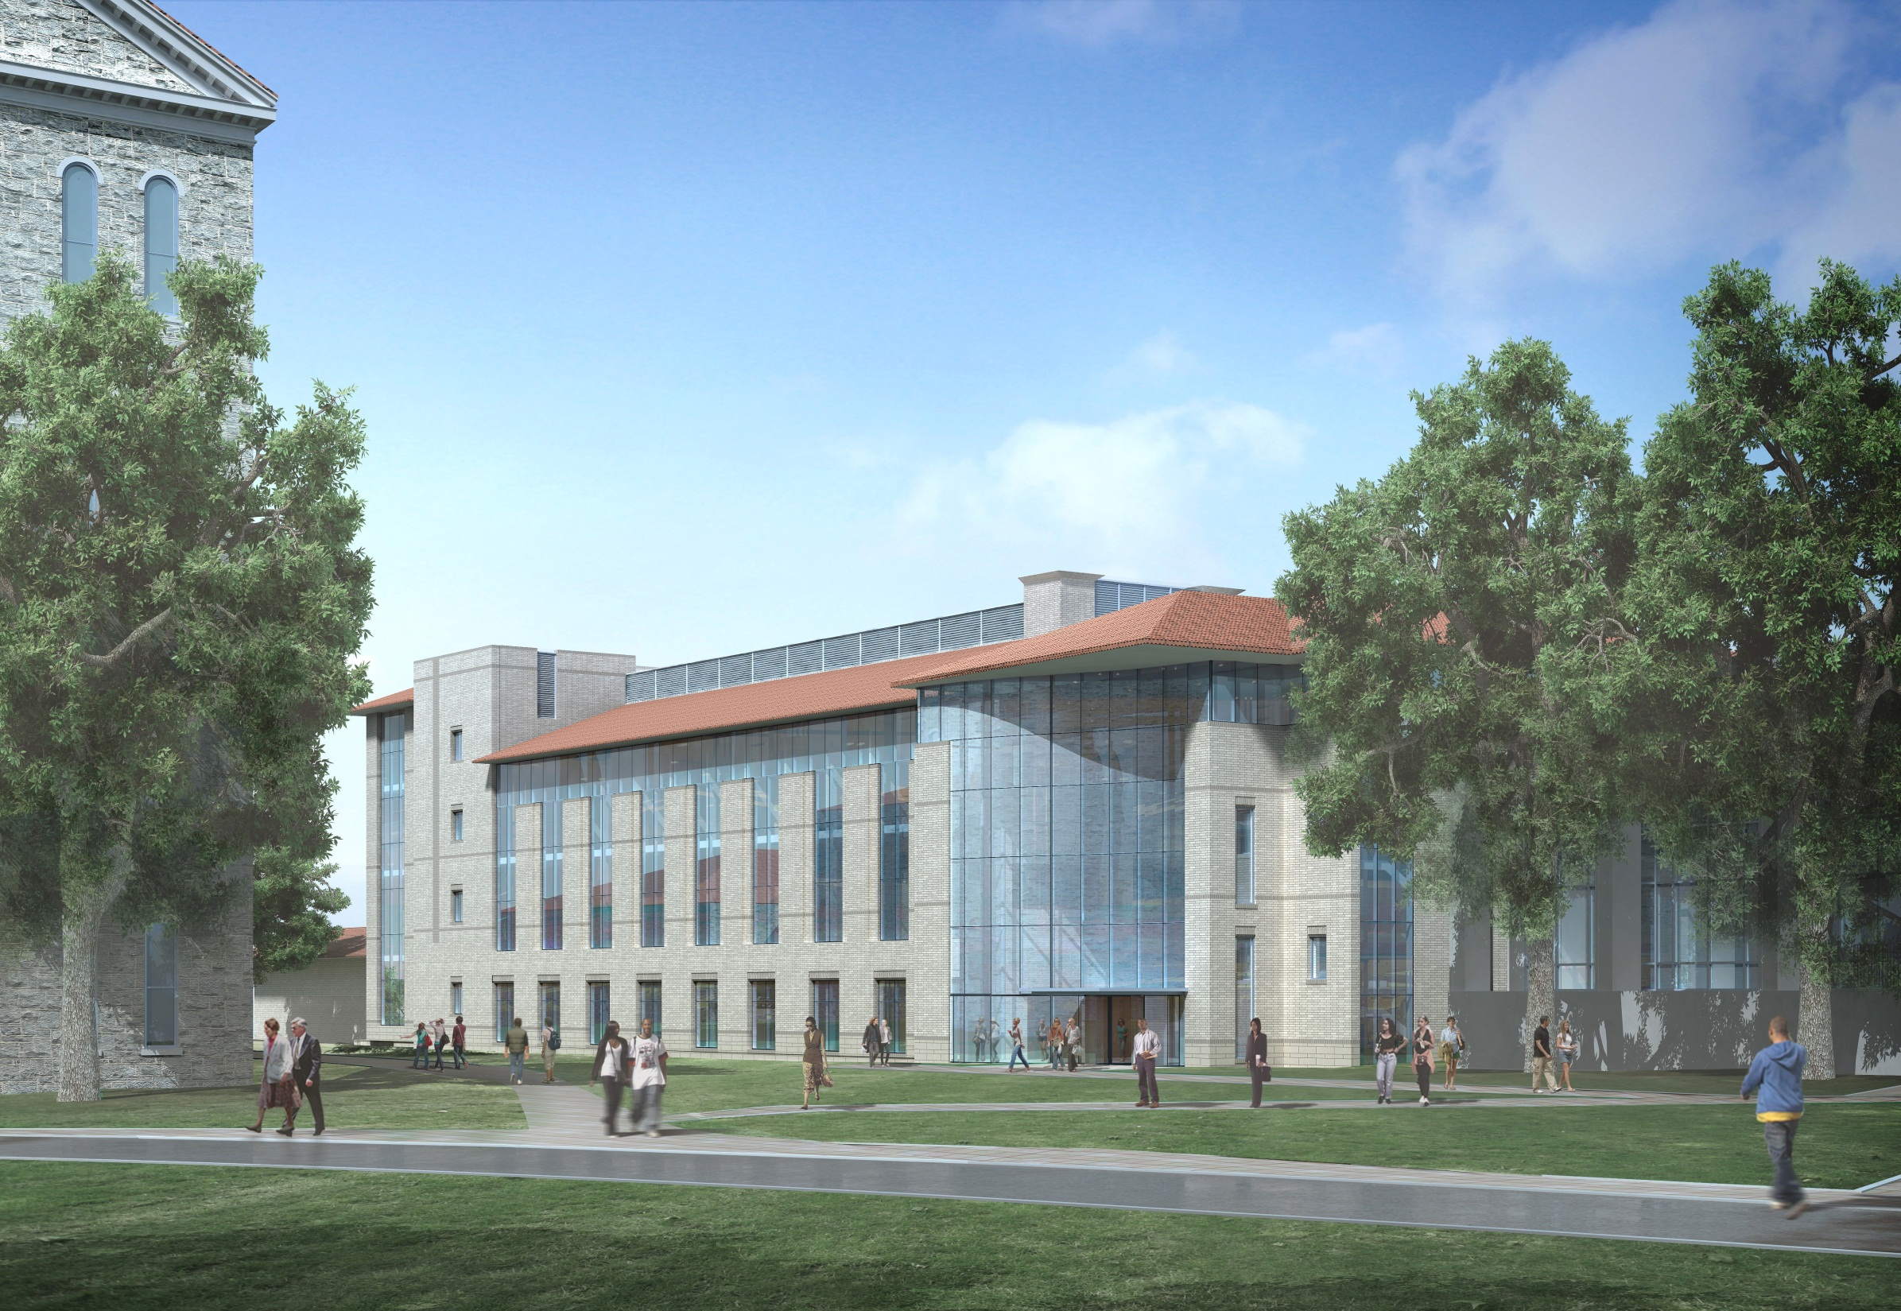
Building Trinity’s Future: The Trinity Academic Center
View of Trinity Academic Center from Main Hall Front Lawn

Slide 27
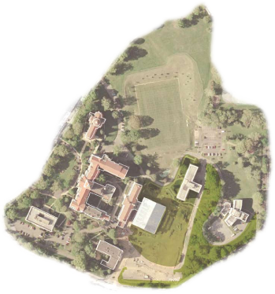
TRINITY HISTORIC BUILDING ZONE
TRINITY GREEN ZONE
ALUMNAE HALL
MAIN HALL
NOTRE DAME CHAPEL
TRINITY ACADEMIC CENTER ZONE
1924
1963
1904
1910
TRINITY CENTER
LIBRARY
1900
SITE FOR NEW ACADEMIC CENTER
1929
1941
2002
1958
SCIENCE
1965
TRINITY HOUSING ZONE

Slide 28
The Trinity Academic Center
The creation of the Trinity Academic Center will ensure Trinity’s long-term academic excellence by supporting Trinity’s key academic objectives:
Contemporary academic classrooms and laboratories are essential to support 21st Century curricula and pedagogy across many disciplines;
Competition for top students and faculty today depends heavily upon the quality and modernity of academic facilities;
Creativity in the modern academic environment demands state-of-the- technology and lab equipment which places significant demands on the infrastructure --- electrical, structural, mechanical, air handling, environmental controls --- requiring new or upgraded systems throughout.
Convenience, access and safety are all high priorities for contemporary students and faculty, requiring academic buildings that can accommodate a broad range of physical needs and that have fire and life safety systems that operate according to modern standards.

Slide 29
Michigan Avenue
New Parking Lots
New campus entrance
Lincoln Road Intersection
Franklin Street
The new Academic Center site plan includes new parking lots on the lower southwest corner of the campus (current Trinity Center lot) and a new entrance for traffic at the gate facing the intersection of Franklin & Lincoln. This will relieve traffic congestion on the front of the campus and Cuvilly drive. Commuters parking in these lower lots can access the Academic Center through the atrium at the auditorium and take the elevators to the main floor, traversing to Main Hall and Alumnae Hall from the Academic Center.

Slide 30
Academic Center Financial Plan
Trinity Academic Center Cost: $55 million
Trinity will support the cost of the new Academic Center through a blend of financing objectives, including:
    At least $30 million through the capital campaign
    A new bond issue or bank loan with debt service calculated according to a schedule that reflects anticipated revenue growth in tuition due to additional enrollments in keeping with the strategic plan goal of 3,000 students by 2015

Slide 31
Trinity Capital Campaign Schematic and Building Project Timetable
CONCEPT DESIGN
APPROVAL TO MOVE TO
HIRE ARCHITECT
Groundbreaking
Target: Fall 2014
Opening
Target: Fall 2016
APPROVAL TO MOVE TO
GROUNDBREAKING
ARCHITECT SELECTION
2 yr construction window
SCHEMATIC DESIGN
FINANCING APPROVAL
CONTRACTOR
SELECTION
$30 M
NUCLEUS PROSPECT CULTIVATION/SOLICITATION
…………........…$6m…............$8m………………$10…………$15...….............................................$25……
2010 -11 -12 -2013 JAN FEB MAR APR MAY JUN JUL AUG SEP OCT NOV DEC 2014 JAN MAR MAY SEP DEC 2015 2016
MAJOR GIFT PHASE
PROSPECT CULTIVATION FOR MAJOR AND PUBLIC PHASES
Financial Analysis, Lender Cultivation, Rating Agency Visits
ZONING MEETINGS, HEARINGS, APPROVALS

Slide 32
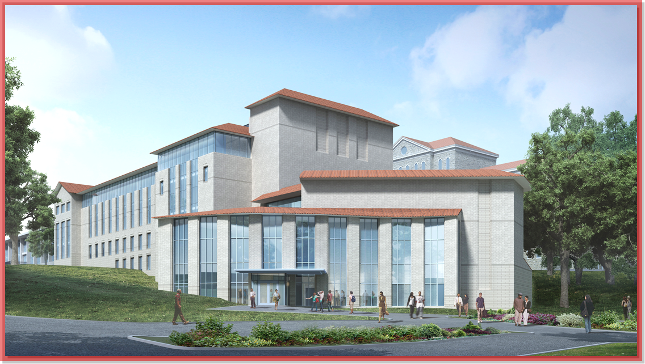
“The project is so grand…The incentives so great….We shall succeed!”
Trinity Founder Sister Mary Euphrasia Taylor, 1897

