Slide 1

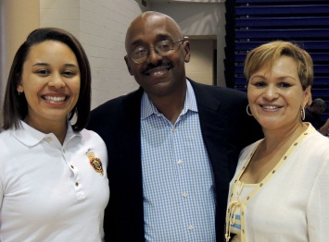



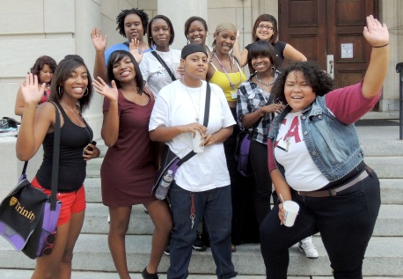

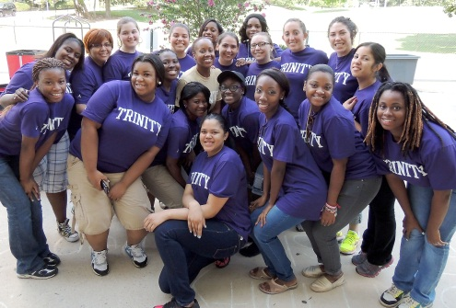


President’s Report to the Faculty
August 24, 2012

Slide 2
NEWS AND ACCOMPLISHMENTS
2,600+ students in Fall 2012
Strong financial performance continues
Facilities and IT Upgrades
    Restrooms
    Wifi, Moodle, Kiosks, Mobile Classroom Finder (bit.ly/whereclass)
Strong new faculty and instructional staff
Partnerships: Jumpstart, KIPP
New women’s college athletic conference
Capital Campaign underway
New D.C. Scholarship Program
Trinity Engagement with Presidential Election!

Slide 3
Challenges
INTERNAL:
Talent searches – more, more timely
NCLEX pass rate – challenge for all
Data tracking graduates – majors
Process re-engineering
Developing proficiency in new deliveries
Innovation and Competitive Drive
EXTERNAL:
Post-election impacts – “Fiscal Cliff”
Declining demographics for traditional education
Threats to Pell Grants and Federal Aid
D.C. politics
Negative vibes for higher education
“The Higher Education Bubble”

Slide 4

ACADEMICALLY
ADRIFT
SCANDALS
GRAD
RATES
JOB
MARKET
ATHLETICS
MOOCs
PELL
GRANTS
THE HIGHER EDUCATION BUBBLE
DEMOGRAPHICS
COLLEGE COST
TECH
ACCESS
ECONOMY
STUDENT
LOANS
AGING
FACULTY

Slide 5

Higher Education Bubble Poppers
Risk
Regulation
Resistance
Regression
Revolution

Slide 6
RISK: HIGHER STAKES, MORE COST
TORT LIABILITIES
    Penn State: consequences for industry
    Colorado Shooter: UC knowns, unknowns
ACADEMIC ERRORS
    Accreditation, e.g., Board of Nursing and NCLEX
    Increasing “failure to educate” litigation
    Graduation Rate focus by regulators
ENROLLMENT DECLINE
    Mismatch with market demand
    New competition
    Reputational breakdown
DISRUPTIVE EXTERNAL EVENTS
    Severe weather impacts
    Terrorism
    Breakdown in city services or utilities
    Disease

Slide 7
REGULATION: INCREASED BURDENS
Title IV: increasing volume and complexity, faculty must pay attention to compliance issues in attendance, academic progress, etc.
Title IX: sexual assault rules
Cleary Act: campus crime compliance
ADA: increased scrutiny for compliance
Discrimination: new areas to consider

Slide 8
Resistance: Consumers
Consumers increasingly resistant to:
    Tuition price increases
    Academic rules
Media, political messages questioning the value of college
Consumers increasingly demanding guaranteed outcomes

Slide 9
Regression: Institutional Culture
In the face of so many external threats, risks, resistance and regulation, institutions have a tendency to pull up the drawbridge
Old governance structures inadequate for contemporary compliance, competitive and consumer demands
“Know how” for contemporary context is a sub-text --- change is hard, takes time to learn new methods, cost of training, release time, etc.
Purpose of higher education – battleground with academy v. corporate culture v. political culture

Slide 10
Revolution: New Competitors
Meanwhile, new competitors are entering the marketplace for higher education every day
    “Pop-up Masters Degrees”
    Teacher credentialing agencies
    MOOCs
Relationship between new competitors and challengers to higher ed methods, e.g., philanthropists engaged in K-12 reform now targeting higher ed

Slide 11
REVOLUTION
ACADEMICALLY
ADRIFT
SCANDALS
GRAD
RATES
JOB
MARKET
RISK
WHAT’S A UNIVERSITY TO DO?
RESISTANCE
ATHLETICS
MOOCs
PELL
GRANTS
THE HIGHER EDUCATION BUBBLE
DEMOGRAPHICS
REGULATION
REGRESSION
COLLEGE COST
TECH
ACCESS
ECONOMY
STUDENT
LOANS
AGING
FACULTY

Slide 12
What Is Trinity’s Response?
Strategic Tactics in 2012-2013:
REVOLUTION = INNOVATION to compete
REGRESSION = INCENTIVES for change
RESISTANCE = COMMUNICATION initiatives
REGULATION = COMPLIANCE enhancement
RISK = RISK MANAGEMENT education

Slide 13
REVOLUTION = INNOVATION
In response to new competitors and increased competition for a shrinking student pool, Trinity will place greater emphasis on innovation
    Each academic unit has a target list of key academic programs for immediate strategic development leading to growth and improved competitive edge
    Creating new pedagogy and using new delivery systems become an increasingly important part of Trinity’s strategic position

Slide 14
STRATEGIC INNOVATION INITIATIVES
COLLEGE OF ARTS AND SCIENCES | Retention and FY Success Math Education Sciences and CBL Program Media Studies Criminal Justice Psychology International Affairs and Government Business Administration
SCHOOL OF NURSING AND HEALTH PROFESSIONS | Occupational Therapy MSN Online Opportunities Physician’s Assistant
SCHOOL OF EDUCATION | Transformation for K-12 Teacher Education Reform Partnership School Leadership Educational Policy Human Services and Behavioral Sciences Online Opportunities
SCHOOL OF PROFESSIONAL STUDIES | Business Administration Programs Intelligence Program Media Studies Pathways for Professional Student Success Online Opportunities

Slide 15
Strategic Initiatives result in enrollments that support Trinity’s strategic plan.
New Academic Center plan is contingent on having program initiatives fulfilled.

Slide 16
REGRESSION = INCENTIVES
Recognizing that fostering the climate for innovation requires investment, Trinity will
    Align faculty development grants with plans that are responsive to Trinity’s strategic development needs in each academic unit
    Consider proposals for additional stipends, summer grants or other compensated time for work on projects aligned with the strategic agenda
    Create additional group faculty development opportunities to help faculty learn more about collaborative thinking on program planning, including networking with funders

Slide 17
RESISTANCE = COMMUNICATION
To improve consumer understanding and acceptance of the value of Trinity’s education and the nature of academic work, Trinity will
    Launch a communication campaign to communicate Trinity’s success in select areas, e.g., Math education, first year experience, innovative pedagogical practices featuring faculty innovators
    Develop more specific programs for students who are new to Trinity to teach them more directly about academic methods expectations, including graduate students

Slide 18
REGULATION = COMPLIANCE
To ensure Trinity’s ability to satisfy federal, state and local regulations at all times, Trinity will
    Implement more comprehensive compliance reviews and disclosures
    Design and implement post-graduate surveys with analytical reports of outcomes
    Increase faculty and staff education on compliance responsibilities
    Analyze new teacher education regulations for impact on Trinity and establish implementation pathways

Slide 19
RISK = RISK MANAGEMENT
To improve Trinity’s ability to manage risk more effectively, Trinity will:
    Conduct more complete reviews of risks, including academic risks
    Implement additional faculty and staff training on risk management
    Revise and improve policies and procedures to improve risk management responses

Slide 20
Key Academic Risk Areas
“Failure to Educate” Complaints
Harassment in response to academic critique
Syllabus as contract
Discrimination in grading
Disabilities Accommodation
Plagiarism and Academic Honesty Charges

Slide 21
New Academic Honesty Process
Provost Oversight of All Cases
Academic Honesty Director Manages Cases
First Offenses managed with less cumbersome process, emphasis on faculty member’s engagement with the director, lesser penalty for first year students
Offenses with severe penalties handled through Academic Honesty Review Board

Slide 22
Academic Honesty Review Board
Why? Risk management requires a stronger process with academic arms-length review of the papers and facts. This is truly a faculty responsibility and faculty review in a formal hearing process will help to protect all faculty.
Who? Six faculty will be selected, four always on the AHRB, two alternates in reserve; director is the chair and does the administrative work
What? One meeting a month to review cases or to discuss ways to improve student and faculty education on issues of cheating and plagiarism
How? Legal counsel will work with the AHRB on training and procedural issues to ensure excellence in execution
Reward? Priceless. And a $500 stipend per semester.

Slide 23
TRINITY RISK MANAGEMENT AT-A-GLANCE CHECKLIST FOR FACULTY
This checklist is a simple reference guide listing key issues in faculty-student interactions. The checklist is not a substitute for the full policy statements on the website at http://www.trinitydc.edu/policies/Home.html
Harassment: A harassment claim can arise in any circumstance in which the claimant perceives a threat or intimidation, or an improper relationship particularly where a power relationship exists, e.g., teacher-student, supervisor-employee. To avoid circumstances that can give rise to harassment claims, follow these simple directions:
  No personal relationships with students.
    Includes: home entertainment, hanging out together after class, casual employment like babysitting
  No financial relationships with students.
    Includes: selling course materials, lending money, collecting fees for excursions
Do not confront a student in public --- in class, on the corridor, in the dining hall --- in a way that the student will construe as possible harassment, e.g., saying to a student in front of the class, “What’s wrong with you, are you stupid?” or “Have you gotten help for your anger management issues?”
Do not share with students jokes, cartoons, photographs, links to websites, newspaper stories, or other material that (a) is not related to the course you are teaching and (b) would not be pleasing to your grandmother. You know what we mean!
Avoid characterizing a student by personal characteristics, e.g., “You with the glasses, what’s the answer?”

Slide 24
Social Networking: Trinity’s official instructional platform is Moodle. Not Facebook.
Do not ‘friend’ your students on Facebook or other sites; do not invite students into your personal stuff.
Do not spy on your students or colleagues on their Facebook pages or other social networking sites.
Do not engage in texting with students, normally they should not have your cell phone number.
Threats: If you feel threatened by a student, or another student reports a threat:
If the potential threat is not immediate and you have time to discuss the situation with your dean or Dean Bowie, please do that first.
If the potential threat occurs in a classroom, depending upon the circumstances try to get another faculty member or dean immediately.
If the student is misbehaving but not threatening, try to get another professional to help you in the moment or on a break.
Call Security if the threat involves the potential for immediate violence. Security will call the police if necessary.
If you believe that a student may be in some kind of danger, contact your dean or Dean Bowie to discuss the matter. Do not try to handle it yourself, do not engage outside assistance on your own. We have personnel here to help students.

Slide 25
Travel: If you would like to take students on a field trip:
Discuss the plan with your dean who will review the plan with you and provide further administrative direction.
Do not take money from the students.
Do not ask the students to send money to a vendor.
NO DRIVING OF STUDENTS. Ever. Our insurance company will not cover you or Trinity.
Email: Email is not secure and is not an appropriate venue for carrying on an argument with a student or a defense against a claim.
Know that Trinity may read all email. Not that we do, but we have the option.
Email is discoverable in any litigation. Think about how it would sound if read in open court.
Never discuss a sensitive student issue on email. Not even with your dean. That’s why we have telephones and offices.
If a student sends you an inappropriate email, do not respond in kind. Discuss with your dean.

Slide 26
Legal and Insurance Coverage: You are covered by Trinity’s legal counsel and insurance policies so long as you follow policies.
If a student makes a legal threat, report that immediately to President McGuire and General Counsel Sarah Phelps.
Trinity’s legal counsel will advise and represent you in legal matters related to your work at Trinity. However, if you ignore Trinity’s policies, we may choose to decline to represent you.
Our insurance company will refuse to cover claims if you negligently or willfully ignore stated policies.
You may not sign any contracts on Trinity’s behalf. All academic contracts should go to the Provost who will review them with the President.
Regulatory: Matters involving federal, state or local regulatory agencies, accreditors, law enforcement and background checks:
All official Trinity compliance activities, reports, accreditation or regulatory activity go through the President.
Governmental officials who call or show up for investigations and background checks should be sent to Security or HR.
You are responsible to observe FERPA, HIPPA and other regulations concerning the privacy of student information.
References:
Faculty members may provide standard academic letters of recommendation for students in their major programs or in related cases where the faculty member can support a student’s application for advanced study or academic recognition.
Trinity has a firm policy that prohibits faculty, administrators or staff from serving as employment references for other faculty, administrators or staff without the specific consent of the Director of Human Resources. Significant claims against you and Trinity can arise from violations of this policy.

Slide 27

STUDENT SUCCESS IS OUR ONLY BUSINESS!

